Slide 1
Policy-relevant results discussion with RTD Introduction
Lead: Steffen M. Olsen

Slide 2
Take-home messages for policy makers
Climate Modelling
Climate Predictions in the Atlantic-Arctic sector: Key take-home messages
Tipping Elements in the Climate System, with a Focus on the North Atlantic: Key take-home messages
Ocean Observations
Atlantic Ocean Observations (AtlantOS BluePrint): Key take-home messages
Impact assessment study on societal benefits of Arctic observing systems: IMOBAR report
Slowing of the Gulf Stream: Briefing Note
Oceans Observations and Predictions: Briefing Note
Representativeness of Ocean Observations and Flux Calculations: Key take-home messages
Subpolar North Atlantic Eastern Boundary: Key take-home messages
Marine Microbiome Roadmap: Key take-home messages
Climate Services
How can we use climate predictions to adapt to the future? Booklet
Recommendations to Horizon Europe on research needs for Climate Modelling and Climate Services: Report
Notes:
See www.blue-action.eu for more details

Slide 3
Contribution to broader strategies
The EU Blue Growth Strategy: Contribution
The UN Sustainable Development Goals: SDG 9, 13, 14
Atlantic Ocean Observations & Transatlantic Cooperation including Galway and Belem Statements: Contributions
Other examples:
UN Ocean Decade, 1st global planning meeting Copenhagen 13-14 May (Predicted Ocean)
Promoting establishment of Arctic GOOS (GRA) in partnership with EUROGOOS and SAON.
Notes:
http://blueaction.eu/

Slide 4
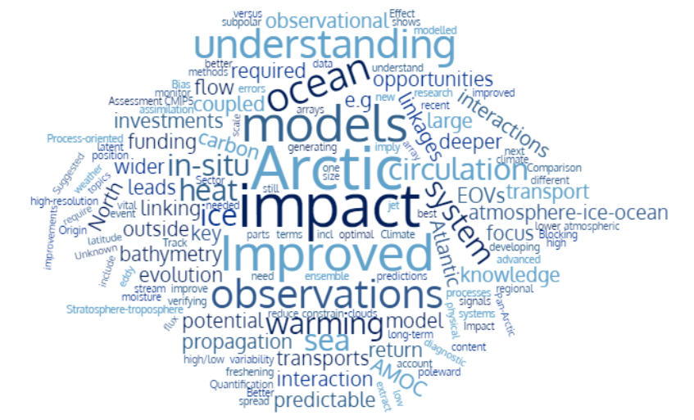
Research gaps for Horizon Europe Reference: WP1-WP4

Slide 5
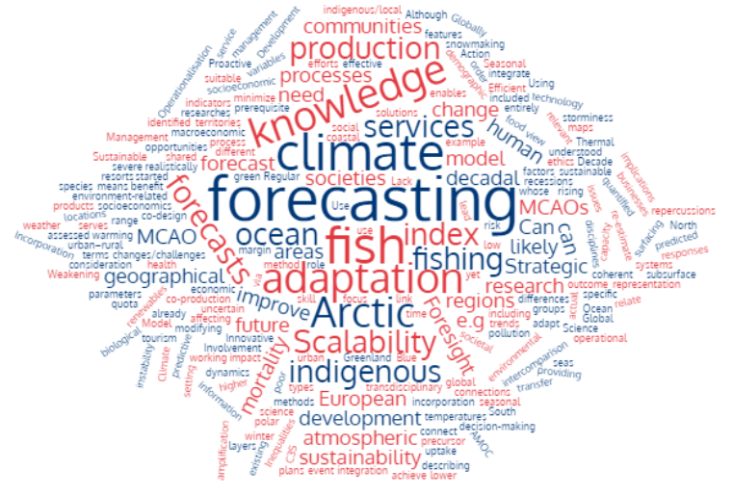
Research gaps for Horizon Europe Reference: WP5 (All the case studies)

Slide 6
Inputs to Horizon Europe 5 Missions Areas
Healthy oceans, seas, coastal and inland waters
Adaptation to climate change including societal transformation
Cancer
Climate-neutral and smart cities
Soil health and food
Notes:
We can contribute to the missions highlighted in blue.

Slide 7
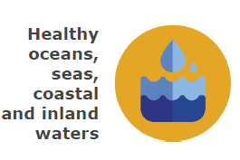
Healthy oceans, seas, coastal and inland waters
Blue-Action can contribute towards the following issues:
transition to a circular and blue economy
adaption to and mitigation of climate change in the ocean
sustainable use and management of ocean resources
ocean governance
ocean economics applied to maritime activities
CS: Snowmaking, Shipping, Fishery
CS: Fishery, Shipping
CS: Fishery
WP2
CS: Shipping, Fishery
Notes:
Blue-Action contribution to the missions highlighted in blue, with the relevant WP= workpackages and CS= case studies inputs in the blue boxes on the right, for specific inputs.
See www.blue-action.eu for more details

Slide 8
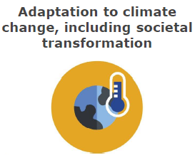
Adaptation to climate change including societal transformation
Blue-Action can contribute towards the following:
offer solutions and preparedness for the impact of climate change to protect lives and assets
support climate adaptation by connecting citizens with science and public policy
demonstrate research and innovation’s relevance for society
All CS
All CS, all WPs
All WPs and CS
Notes:
Blue-Action contribution to the missions highlighted in blue, with the relevant WP= workpackages and CS= case studies inputs in the blue boxes on the right, for specific inputs.
See www.blue-action.eu for more details

Slide 9
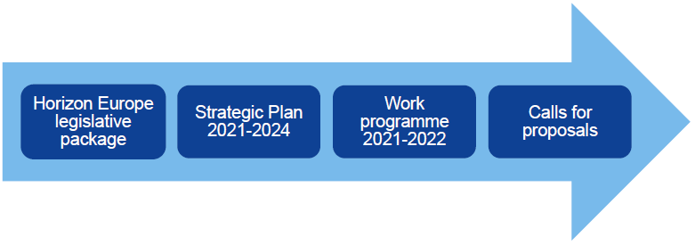
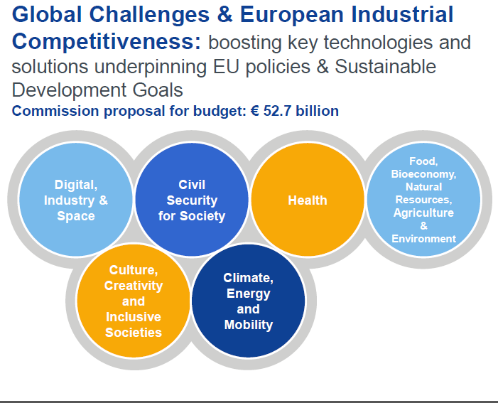
Inputs to Horizon Europe Pillar 2
Climate: WPs all, CS on Snowmaking, TRM, Shipping, Fishery, Yamal
CS: TRM
CS: Fishery, Yamal, Snowmaking
Notes:
Blue-Action contribution to the missions highlighted in blue, with the relevant WP= workpackages and CS= case studies inputs in the blue boxes on the right, for specific inputs.
TRM= temperature related mortality case study.

Slide 10
Thank you!
The Blue-Action project has received funding from the European Union’s Horizon 2020 research and innovation programme under grant agreement No 727852
Twitter: @BG10Blueaction
Zenodo: https://www.zenodo.org/communities/blue-actionh2020
www.blue-action.eu

