Slide 1
WP3
Linkages of Arctic climate changes to lower latitudes
Lead: Yongqi Gao (NERSC) and Guillaume Gastineau (CNRS)
Presenter: Yongqi Gao (NERSC)

Slide 2
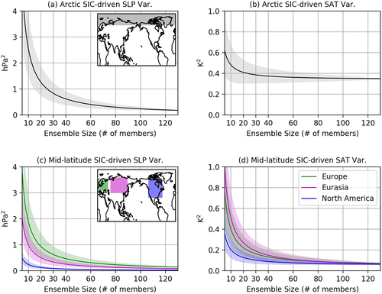
Arctic Warming impacts by atmospheric pathways
Liang et al. 2020: Geophysical Research Letters, 47, e2019GL085397
https://doi.org/10.1029/2019GL085397

Slide 3
Arctic Warming impacts by atmospheric pathways
He S.P., 2020: Geophysical Research Letters, https://doi.org/10.1029/2020GL087212

Slide 4
Arctic Warming impacts by atmospheric pathways
What is the role of ocean-atmosphere coupling in bridging to Arctic warming impact to midlatitudes and beyond?
Two single model studies :
How sea ice loss contributes to the North Atlantic minimum warming (Suo et al. 2017)
Role of sea ice constraining method and the near-term impacts of sea-ice loss in tropics and North Atlantic (Simon et al., submitted)
Anomalies related to weak sea ice loss (IPSL) from Simon et al (submitted)
SST (in K)
Anomalies related to large sea ice loss (BCM) from Suo et al. 2017
SST (in K)
Rainfall (mm d⁻¹)

Slide 5
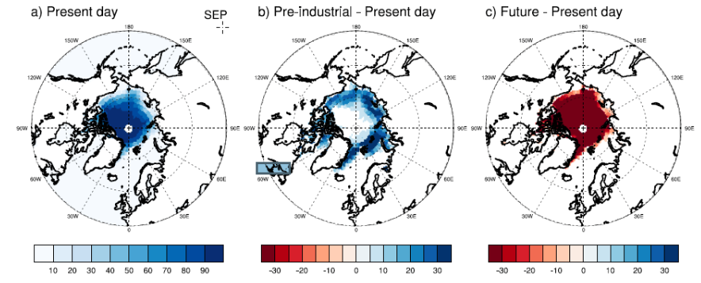
Upcoming works
What is the role of ocean-atmosphere coupling in bridging to Arctic warming impact to midlatitudes and beyond?
Coordinated experiments designed: 14-month coupled simulations with sea-ice loss:
  in collaboration with APPLICATE and CMIP6, so that large number of models
  comparison with atmosphere-only and coupled long-term simulations
  Subset of experiments designed to study the role of AMV and IPV for the sea ice loss impacts
Smith et al., 2018, GMD
Remaining questions:
  Why are model experiments seems to underestimate the response to sea ice loss compared to observations?
  Links between mean state and response to sea ice loss
  Oceanic and atmospheric pathway for sea-ice loss response

Slide 6
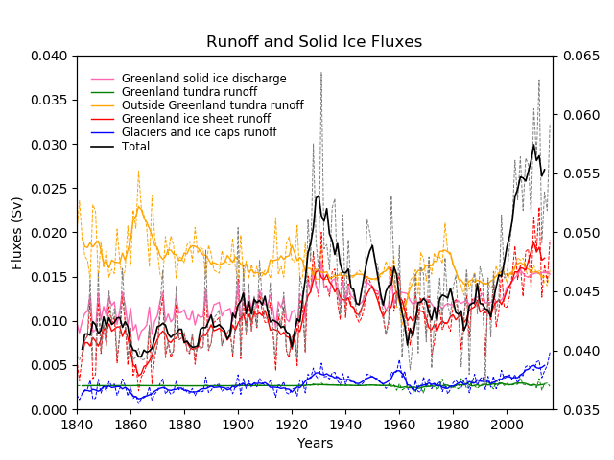
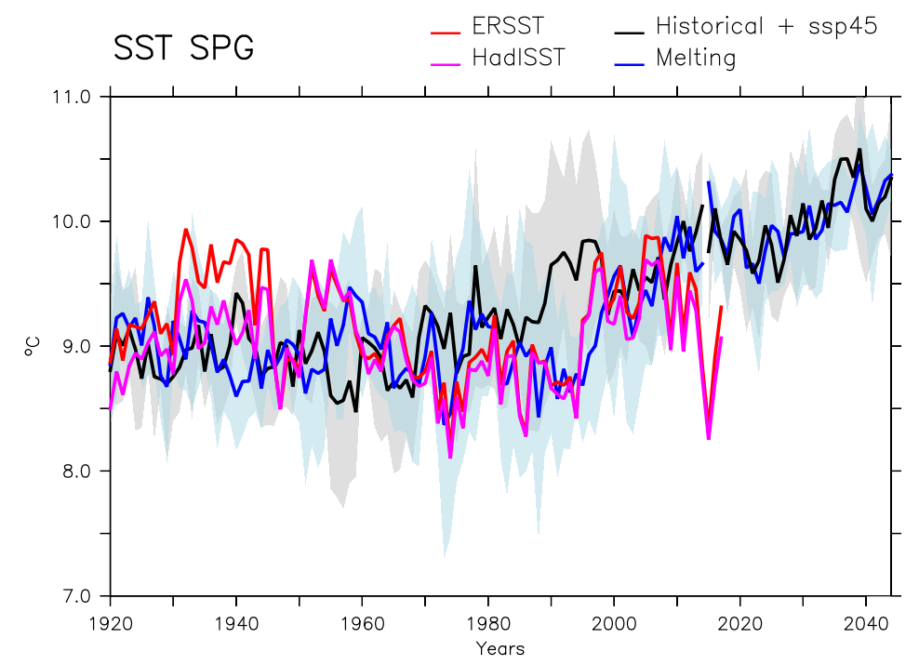
Impact of Arctic Ocean freshening on Northern Hemisphere climate
New Greenland ice sheet melting scenario for 1920-2014 based on Bamber et al. (2018) and Box and Colgan (2013)
Imposed in 10-member simulations from IPSL-CM5A-LR OAGCM (about 1° resolution)
Decrease of convection in the Labrador Sea over the period
About 0.5 Sv of additionnal AMOC weakening over the period
Impact on decadal variability of SST and the 1995 abrupt warming: better representation (!)
Notes:
New Greenland ice sheet melting scenario for 1920-2014 based on Bamber et al. (2018) and Box and Colgan (2013)
Imposed in 10-member simulations from IPSL-CM5A-LR OAGCM (about 1° resolution)
Decrease of convection in the Labrador Sea over the period
About 0.5 Sv of additionnal AMOC weakening over the period
Impact on decadal variability of SST and the 1995 abrupt warming: better representation(!)

Slide 7
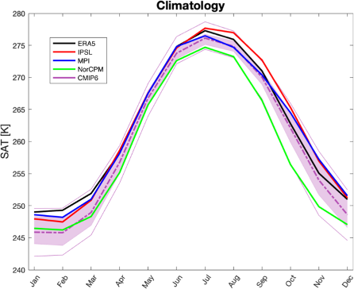
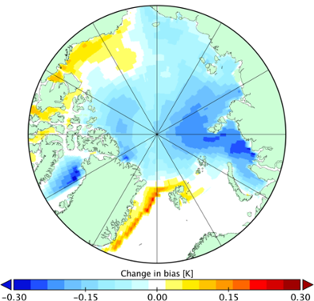
Improve representation of surface heat flux in the Arctic
New scheme to describe enhanced fluxes from sea ice leads included in NorESM
20 member ensemble AGCM simulations performed with NorESM for historical period
Reduced cold bias in surface air temperature over sea ice in winter
Most CMIP6 models have too-cold winters over sea ice
Implementation may improve capacity to represent Arctic warming, its regional impact, and prediction skill
Davy and Outten 2020 Journal of Climate (in revision)

Slide 8
Impacts
Improve the capacity to respond to the impact of climatic change on the environment and human activities in the Arctic, both in the short and longer term
Improve the capacity of climate models to represent Arctic warming and its impact on regional and global atmospheric and oceanic circulation
Contribution to the IPCC Special Report on the Ocean and Cryosphere in a Changing Climate for which Didier Swingedouw (CNRS-EPOC) was lead author of the chapter 6 “Extremes, Abrupt Changes and Managing Risks”

Slide 9
Research Gaps
We need:
Assessment, Origin, Quantification of Arctic warming (low and high Arctic warming)
Impact of high/low Arctic warming
Pan-Arctic sea ice impact versus regional sea ice impact
Bias in sea ice impact in the coupled system
Unknown impact of leads in coupled system
Effect of leads on latent heat flux, atmospheric moisture content and clouds

Slide 10




Thank you!
The Blue-Action project has received funding from the European Union’s Horizon 2020 research and innovation programme under grant agreement No 727852
Twitter: @BG10Blueaction
Zenodo: https://www.zenodo.org/communities/blue-actionh2020
www.blue-action.eu

