Slide 1
EU H2020 Blue-Action
Workpackage 3
Linkages of Arctic climate changes to lower latitudes
Leads: Yongqi Gao (NERSC) and Guillaume Gastineau (CNRS)

Slide 2
Arctic Warming (Amplification)
Sea ice
Heat and moisture transport
Inflows of Atlantic and Pacific waters
Local radiative effect
Increased emittance of blackbody
Reduced air pollution et al.

Slide 3
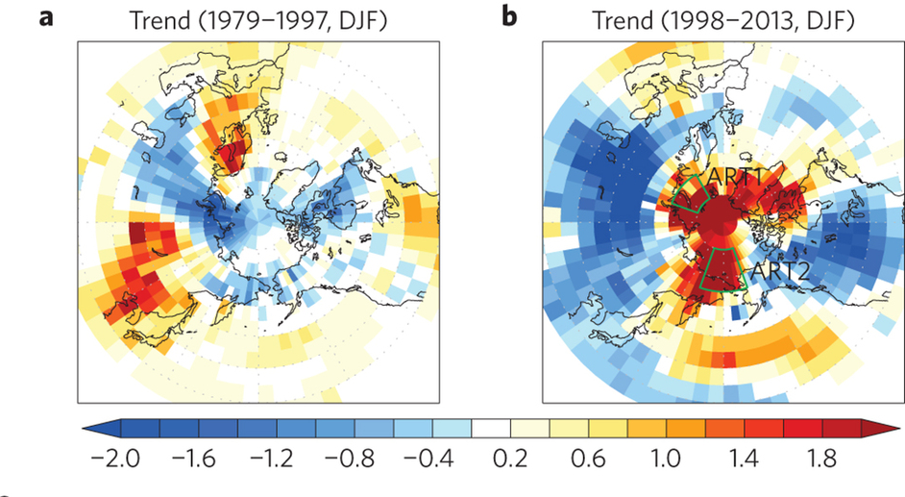
Arctic Warming
Kug et al. 2015
Notes:
Figure 1 | SAT trends and Arctic temperature (ART) indices. a,b, The linear trend in surface air temperature during December–February for the periods 1979/1980–1997/1998 (a) and 1997/1998–2013/2014 (b) from the observed DATA. Arctic warming (winter) has decadal variations.

Slide 4
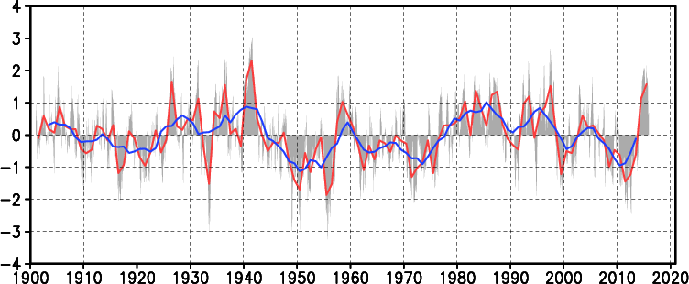
PDO (1901-2015)
http://ds.data.jma.go.jp/tcc/tcc/products/elnino/decadal/pdo_doc.html
Notes:
After 1980s, AMO switched from negative phase to positive phase whereas PDO switched from positive phase to negative phase

Slide 5
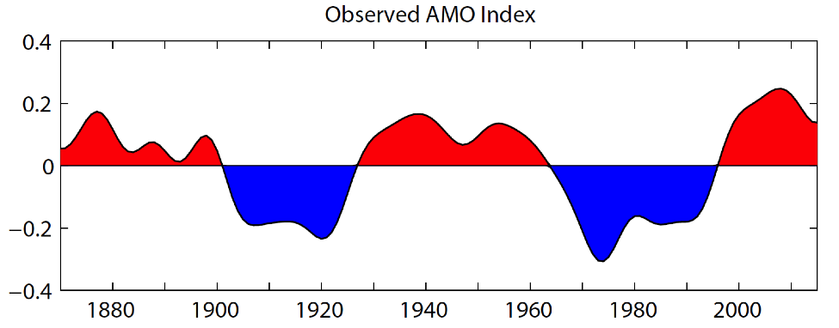
AMO (1870-2015)
https://climatedataguide.ucar.edu/climate-data/atlantic-multi-decadal-oscillation-amo
Notes:
After 1980s, AMO switched from negative phase to positive phase whereas PDO switched from positive phase to negative phase

Slide 6
Arctic Warming (PDO)
Screen and Francois 2016 NCC

Slide 7
Arctic Warming (AMO)
Johannessen et al. 2016

Slide 8
Extreme Warming Arctic
(Winter 2015/2016)
Overland and Wang 2016

Slide 9
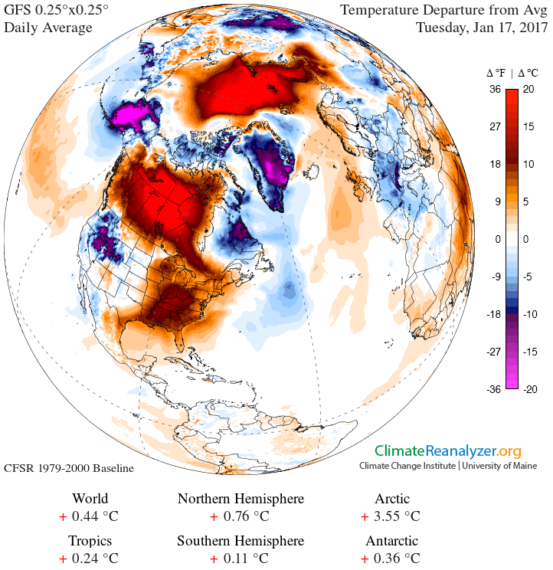
Daily SAT Anomalies (Jan.17th,2017)
http://climatereanalyzer.org/
Notes:
After 1980s, AMO switched from negative phase to positive phase whereas PDO switched from positive phase to negative phase

Slide 10
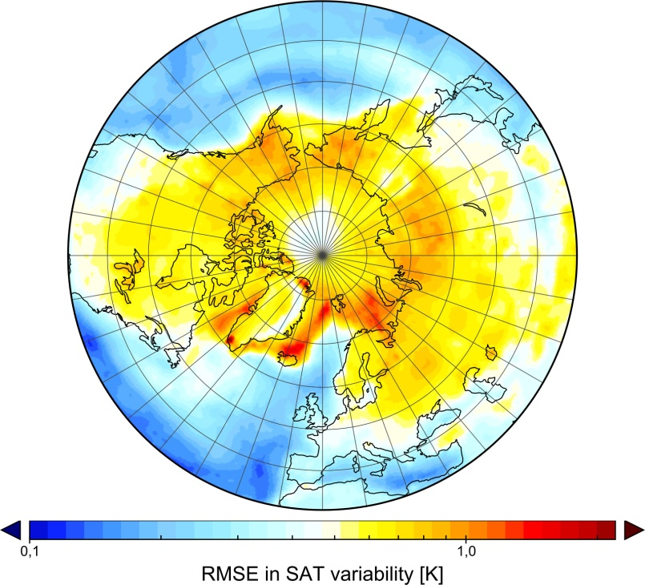
Global Climate Models (CMIP5)
Davy and Esau 2014
RMSE in SAT variability [K]
Average RMS error in SAT in 36 CMIP5 GCMs
Notes:
Global climate models are biased towards producing deeper-than-observed boundary layers and there is a lot of variation in the boundary-layer depth in these models, especially in shallow, stably-stratified layers.
Since these shallow boundary layers have the most influence on the climatology of the surface temperature we might expect that the models perform worst in shallow boundary layers. And if we take the ensemble mean error in the surface temperature variability from the CMIP5 models compared to reanalysis, we get this pattern.
We can see some hotspots over the marginal ice zone where the models disagree as to the presence of sea-ice. But there is a generally large discrepancy between the models and observations across the Arctic basin and the high-latitude continental interiors: regions that are characterized by the frequent occurrence of shallow, stably-stratified boundary layers.
However, it can be more informative if we look at model error in parameter space so that we can directly assess how well the models perform under different conditions of the boundary layer (Figure 2). This is the RMS error in model temperature as a function of the surface sensible heat flux for 36 climate models from CMIP5 with the average highlighted in red. The negative values indicate shallow, stably-stratified boundary layers and more positive values the deeper, convective boundary layers. As you can see model error is relatively insensitive to the boundary layer depth across a range of convective conditions, but we see a dramatic increase in model error as we go towards increasingly shallow boundary layers, with typical RMS errors of around 15 Kelvin.
The bar chart indicates the frequency of occurrence of the given heat flux in the models, so these cases where the models have very large errors are relatively rare, so a model might do reasonably well at describing hemispheric temperatures, even if it does very poorly under these conditions.

Slide 11
Arctic Warming and Eurasian Cooling
Cohen et al., 2014

Slide 12
PDO Modulation
PDO-
Li F., Wang H.J., Gao Y.Q. 2017 (unpublished)

Slide 13
WP3 Objective
Enhancing the predictive capacity beyond seasons in the Arctic and over the Northern Hemisphere by improved representation of Arctic warming, synthesising observations and assessing model performance.
Innovating the descriptions of key processes specific to the Arctic in prediction systems by focussing on skilful simulation of the stable planetary boundary layer in the Arctic key to the development of Arctic weather systems and for representing the impact of climate change in the Arctic/climate amplification and by implementing the effects of extremely varying runoff from the Greenland ice-sheet
Reducing and representing the uncertainty in prediction systems by development of improved system configurations and process representation
Optimizing observational systems for predictions by identification of climate model limitations with focus on recent climatic extremes
Quantifying the impact of recent rapid changes in the Arctic on weather and climate extremes by: employing coordinated multi-model sensitivity experiments to disentangle the impact on Arctic climate of direct external forcing from changes related to natural modes of climate variability in the Northern Hemisphere. Additional emphasis will be put on the impact of the transition of the Greenland Ice Sheet mass balance

Slide 14
Tasks
Arctic warming impacts by atmospheric pathway (Atmospherical General Circulation Model) (Partners: NERSC, CNRS-LOCEAN, UoS, MPI-M, UniRES, DMI, CMCC, NLeSC, WHOI, IAP-NZC, IAP-RAS)
Ocean influence on Arctic warming impacts (Coupled Climate Models) (Partners: CNRS-LOCEAN, NERSC, MPIM)
Impact of Arctic Ocean freshening on Northern Hemisphere climate (Partners: CNRS-EPOC, CNRS-LOCEAN)
Improve representation of surface heat flux in Arctic (Atmospherical General Circulation Models) (Partners: NERSC, CNRS-LOCEAN, MPIM, IAP-NZC)

Slide 15
Linkages to other WPs

