Slide 1
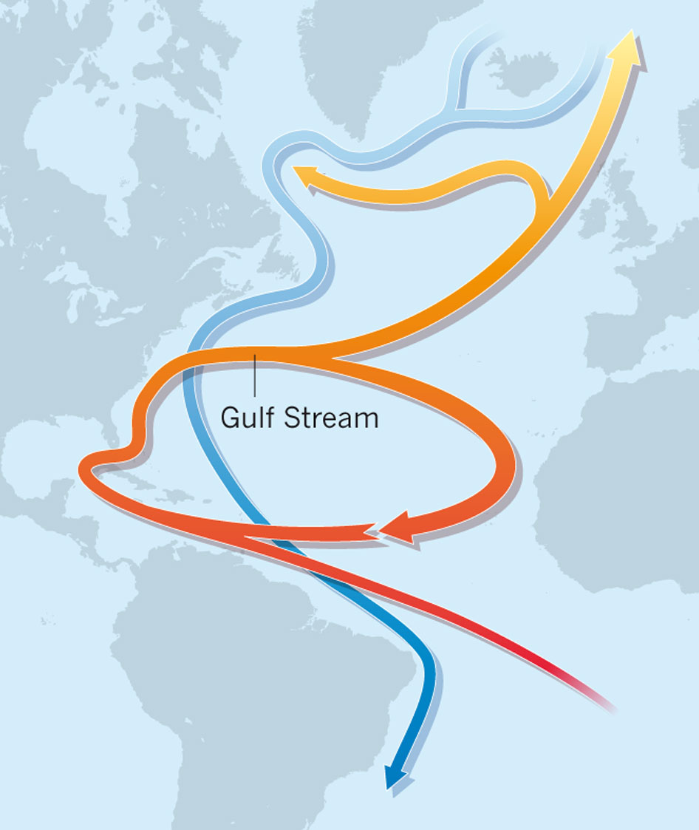
The Atmospheric Response to
the 2015 Atlantic Cold Blob
Sybren Drijfhout¹, Jennifer Mecking¹
Joel Hirschi², Adam Blaker², Aurélie Duchez²
¹ University of Southampton
² National Oceanography Centre, Southampton

Slide 2
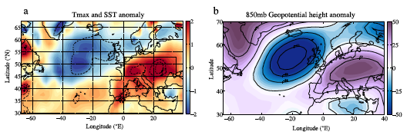
Motivation
Duchez et al. 2016

Slide 3
Model Set-up
State of the art coupled climate model, HadGEM3 (GC2):
Atmosphere, Ocean, Sea-Ice and Land-Surface Models
Ocean: NEMO, ORCA025, ¼° horizontal resolution (GO5)
Atmosphere: UM, N216, approx. ½° latitude by ¾° longitude (GA6)
Simulating 1 year requires 1152 cores to compute for 18 hours
DFS5.2
Atmosphere UM
Ocean
NE MO 3.6
(LIM2)
Land-Surface
JULES
Ocean
NEMO 3.4
Sea-Ice
CICE

Slide 4
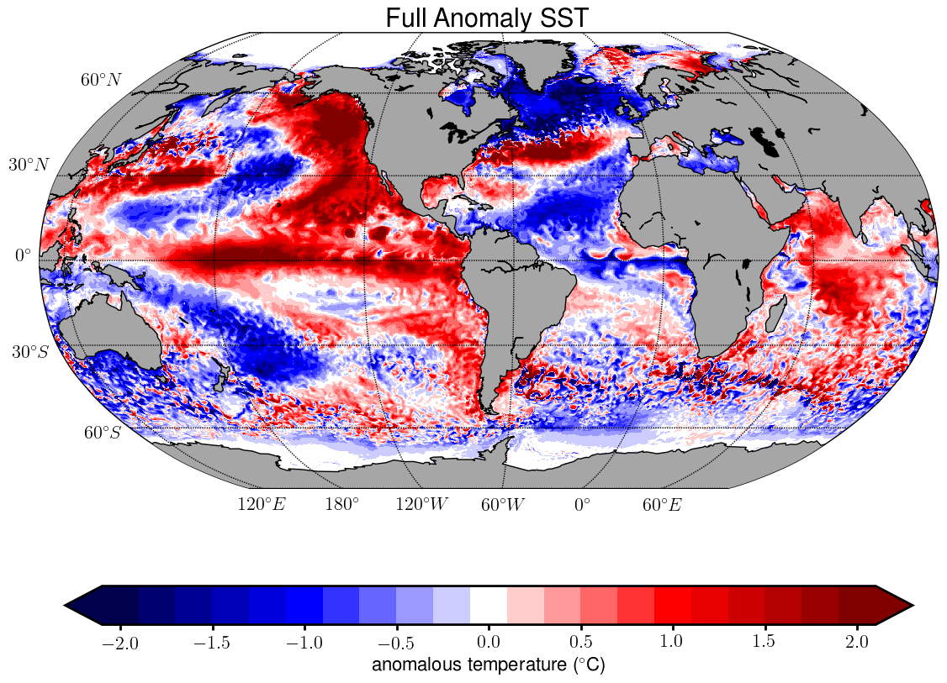
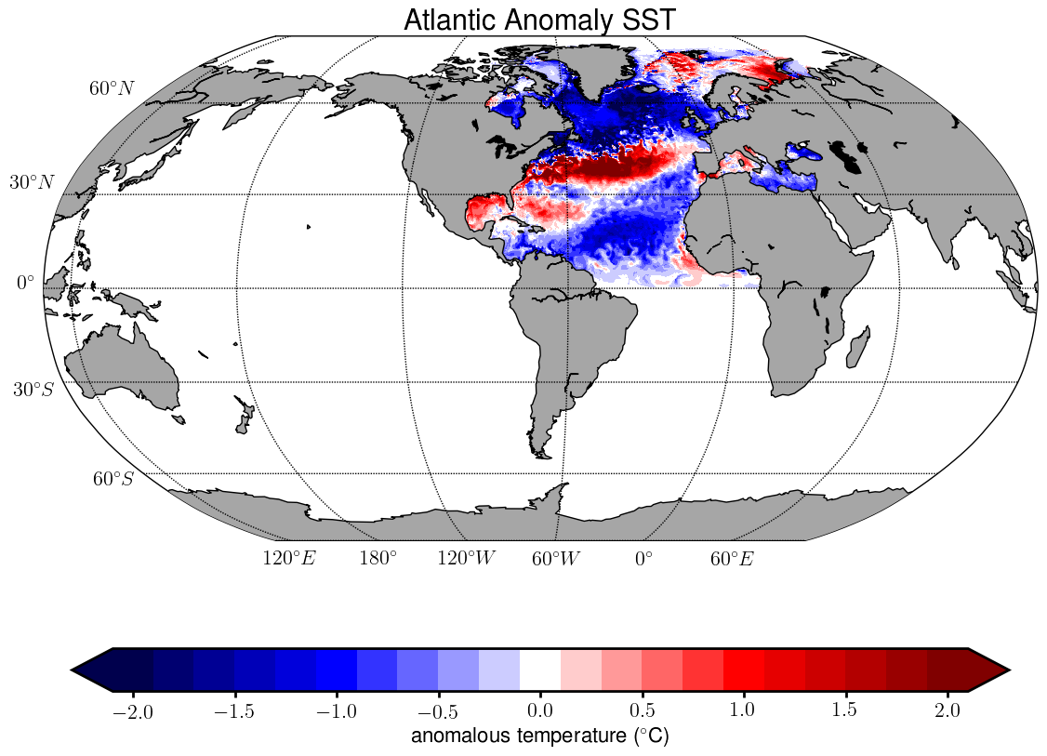
Experimental Set-up
Initialized on June 1st, 2015 from historical+rcp4.5 HadGEM3 experiment, with the exception of 3D ocean temperature and salinity
3D ocean temperature and salinity climatology is defined as mean May&June from 2010 to 2014
3 experiments are set up:
Mean: T&S climatology
Full: T&S clim. + June 2015 global anomaly from ORCA025 hindcast
Atl: T&S clim. + June 2015 N. Atl. anomaly from ORCA025 hindcast

Slide 5
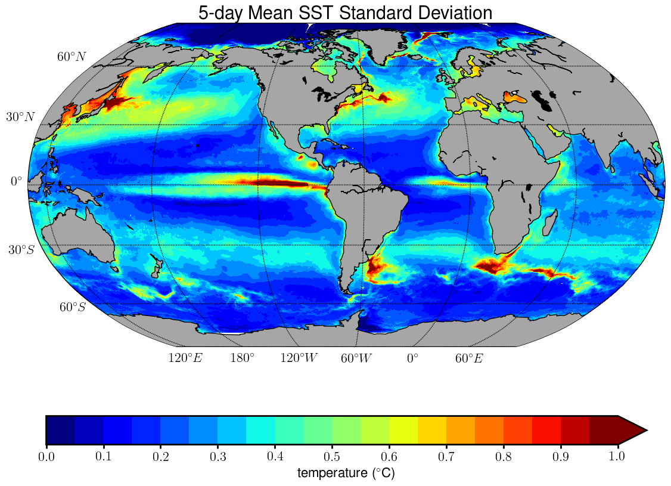
Ensemble Set-up
Ensemble members created by perturbing the SST with a white noise proportional to differences in 5 day means in NEMO hindcast
SST perturbation is applied to ocean surface and tapered towards zero over the upper 50 m
15 ensemble members for each of the 3 experiments are created

Slide 6
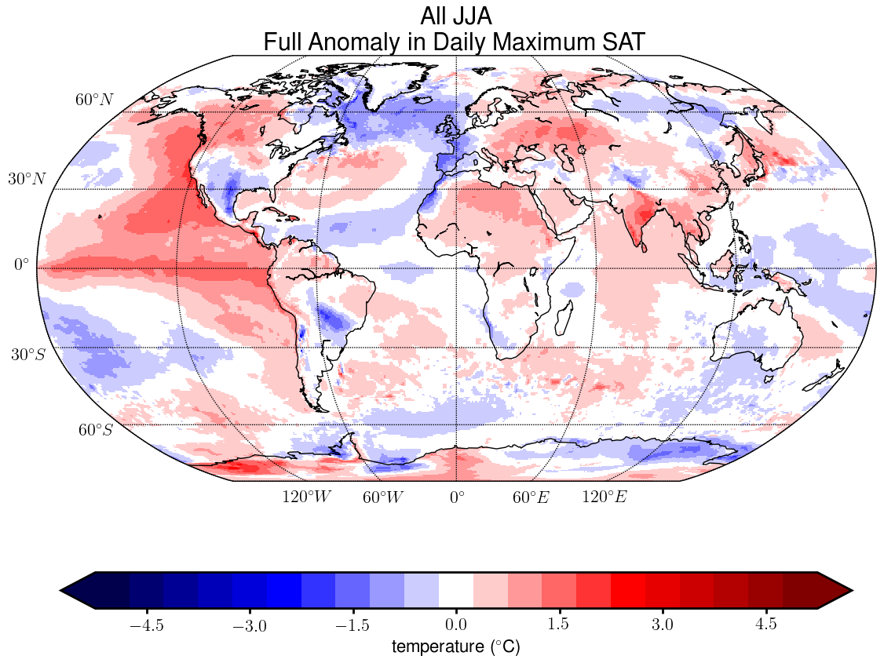
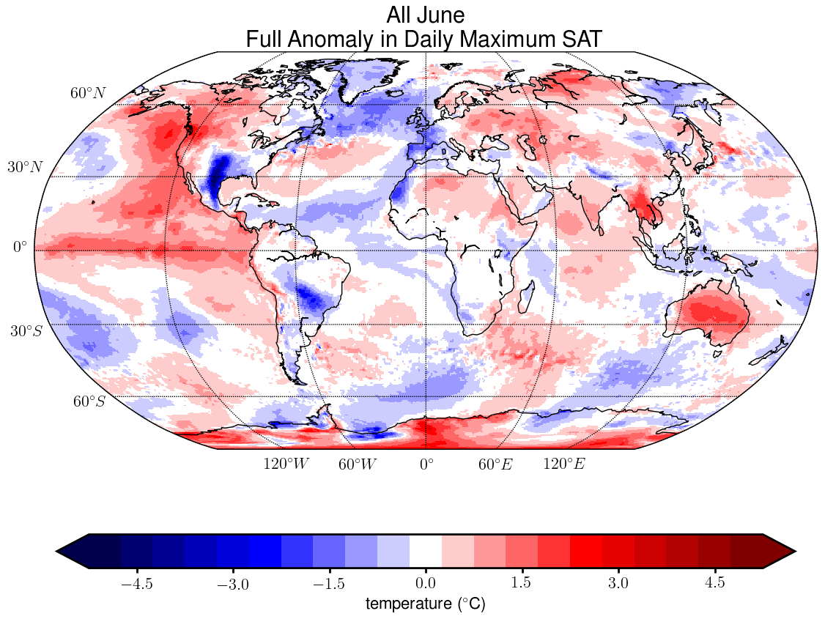
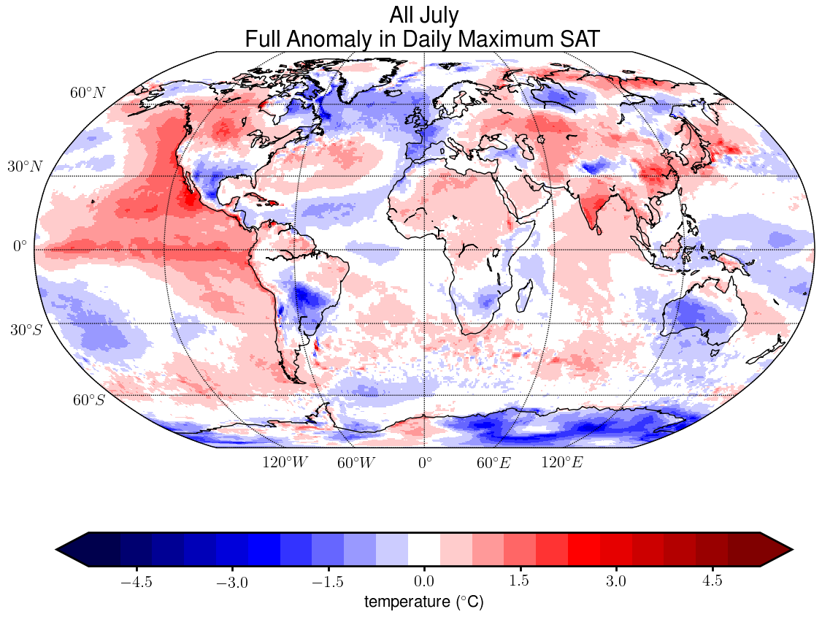
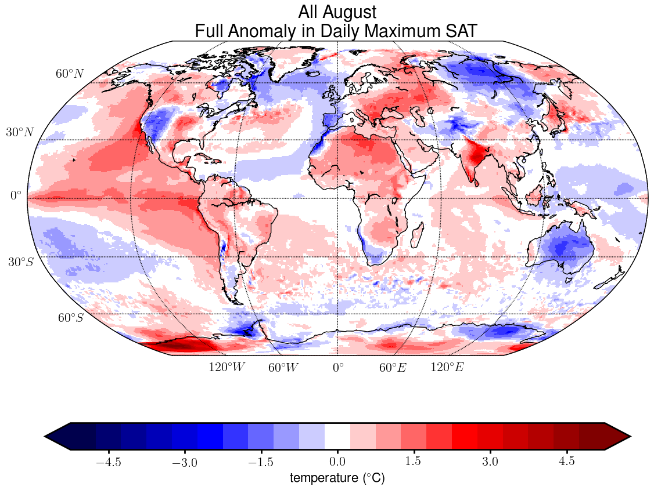
Full Anomaly - SAT
Anomaly = ensemble mean (Full – Mean Experiments)

Slide 7
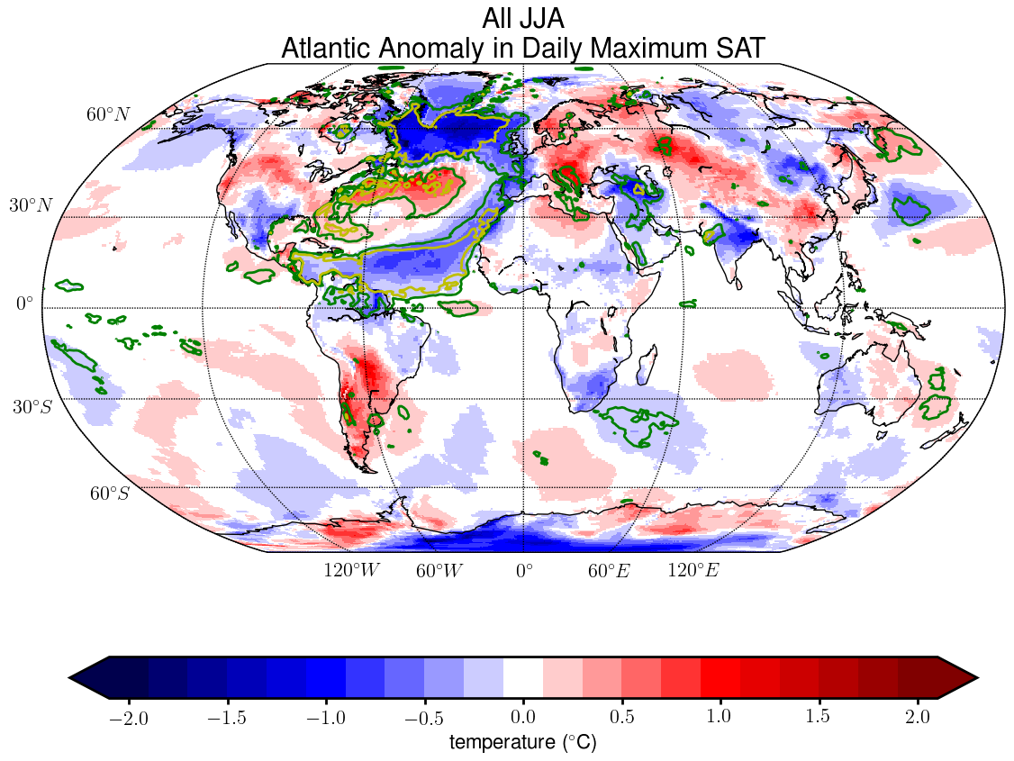
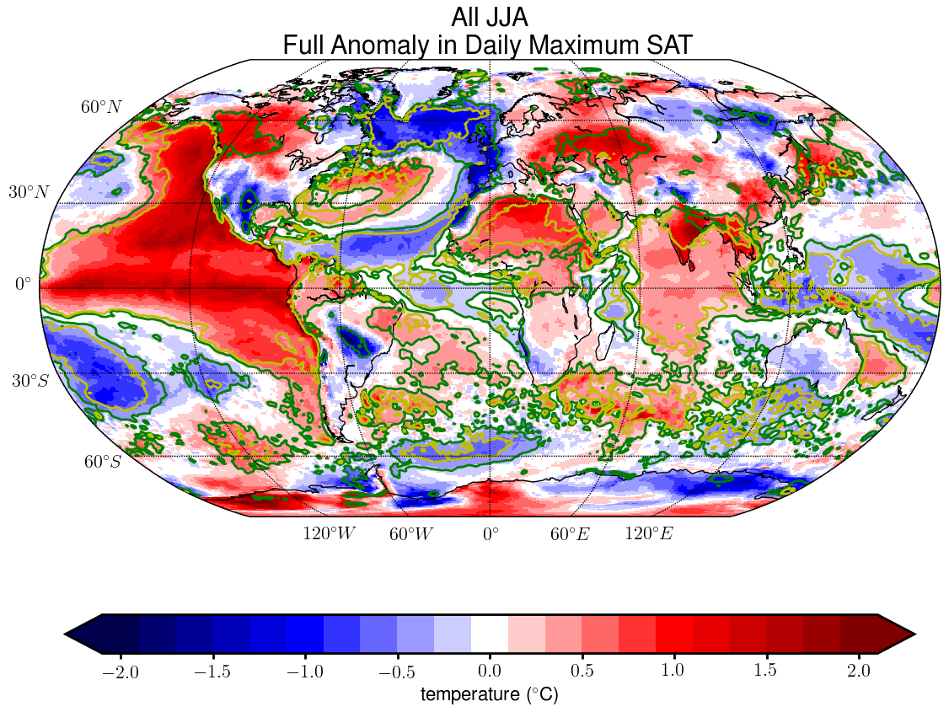
Atl. vs Global Anomaly - SAT
Anomaly = ensemble mean (Atl/Glob – Mean Experiments)
Anomaly within 1 standard deviation of Mean Experiments
Anomaly within 2 standard deviations of Mean Experiments

Slide 8
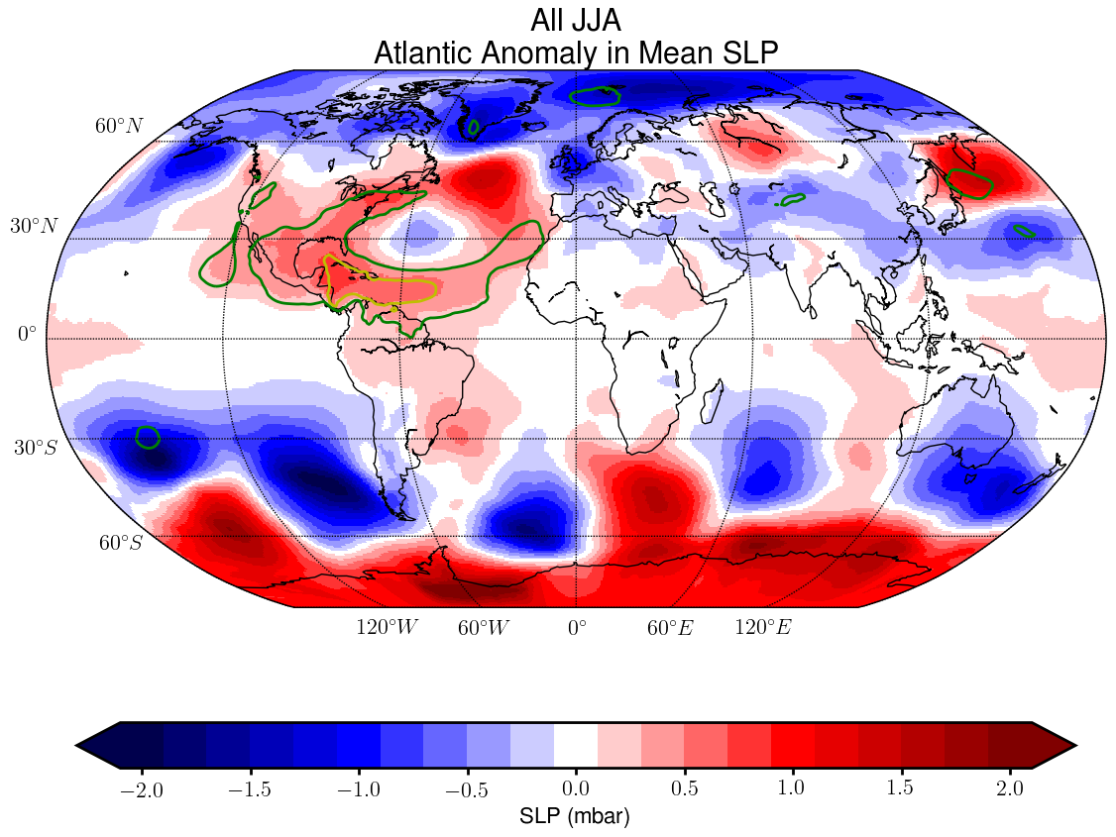
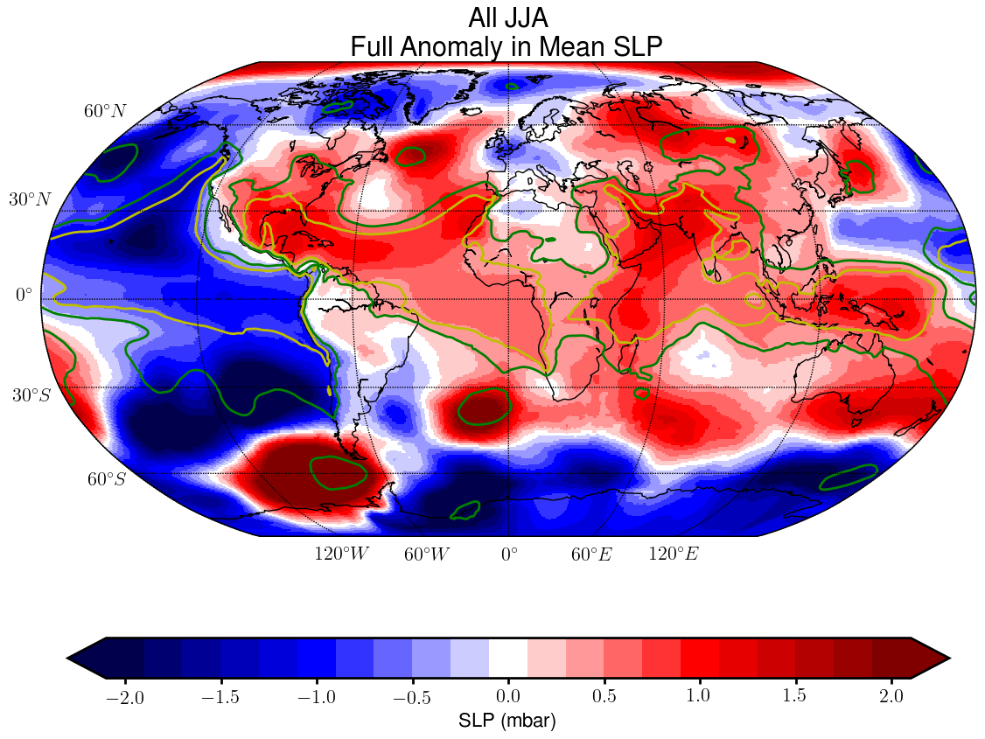
Atl. vs Global Anomaly - SLP
Anomaly = ensemble mean (Atl/Glob – Mean Experiments)
Anomaly within 1 standard deviation of Mean Experiments
Anomaly within 2 standard deviations of Mean Experiments

Slide 9
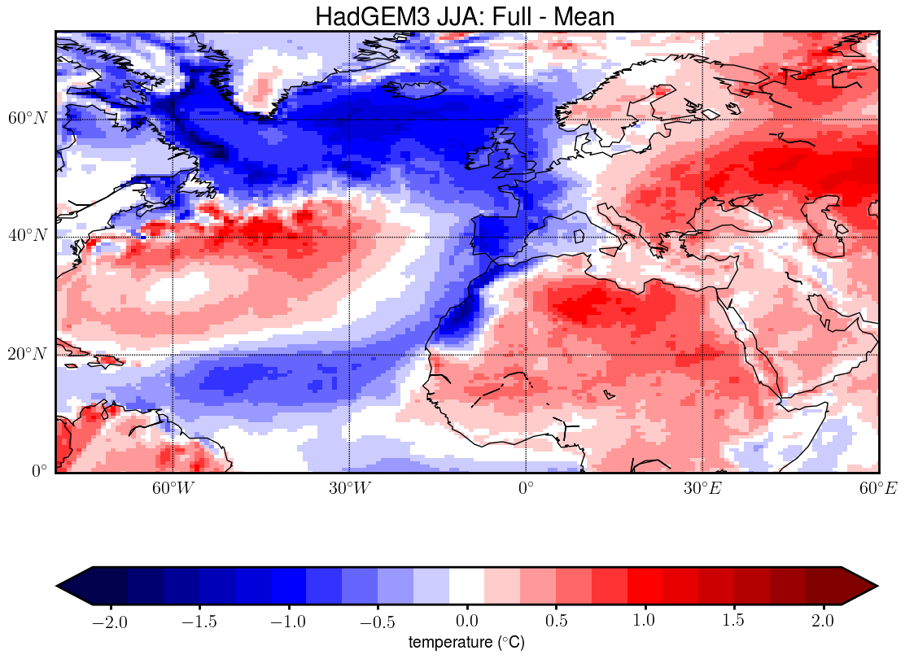
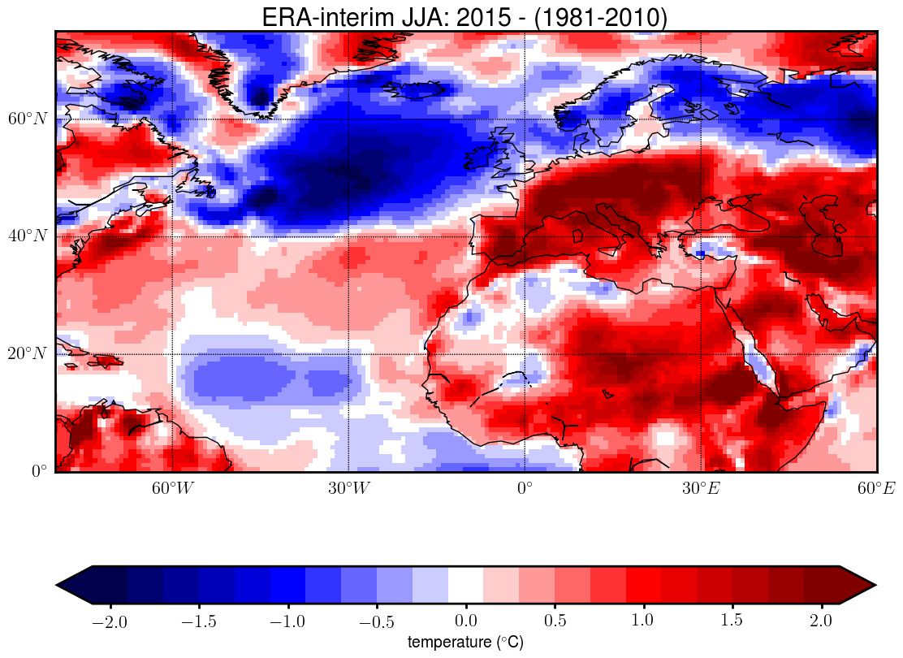
The bias in SAT response

Slide 10
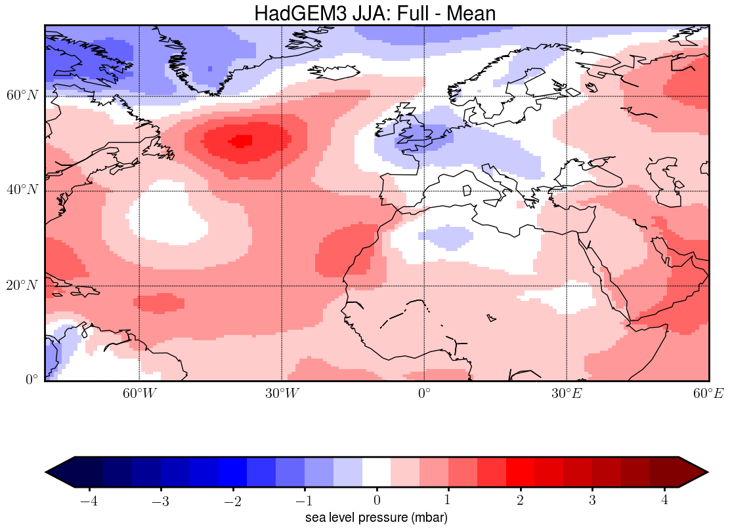
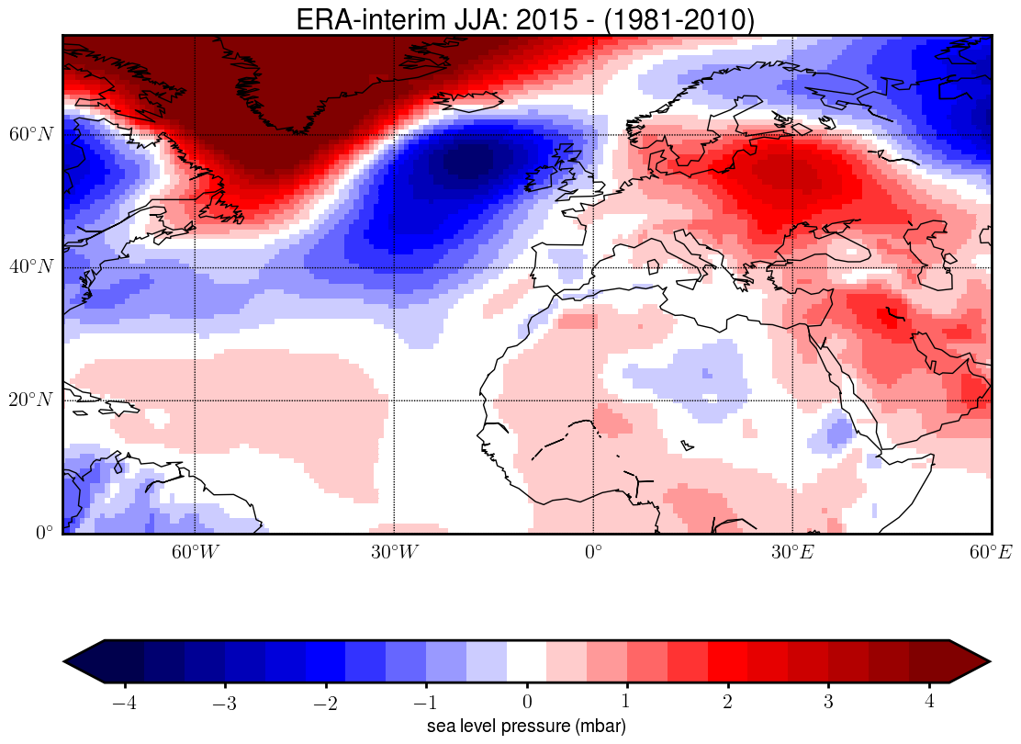
The bias in SLP response

Slide 11
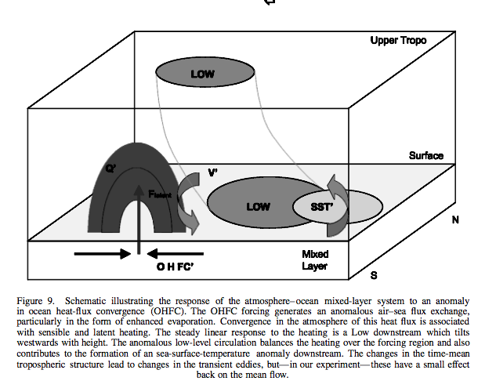
The theoretical response
Sutton and Mathieu 2002
Hoskins and Karoly 1981
An anomaly in OHFC should provoke a high downstream of the cold blob
The model’s high is too much above the cold blob invoking cold northerly winds at its eastern side (over W-Europe)
The Obs show the high farther to the east than theory predicts and a low over the cold blob
By Chance? Or did we overlook some other crucial element in the initial conditions?

Slide 12
Conclusions
Initialisation with May 2015 ocean temperatures leads to anomalously warm JJA over Central/Eastern Europe
Confining SST anomalies to the Atlantic still leads to anomalously warm JJA conditions, but the signal is slightly weaker
Using T ((and S-anomalies) from a hindcast with the same ocean model is a promising route for initialising coupled models when making intra-annual and interannual predictions
The associated SLP response puts the expected high pressure system to far west in the model, while in the obs it is located farther east than expected from theory, as a result western Europe is too cold in the model
We have no clue as yet what the cause is of this discrepancy

