Slide 1
Blue-Action
Context of implementation/monitoring
Franz IMMLER
Head of Sector, EASME B.2.2
H2020 Climate Action
Blue-Action Kick-off meeting
Potsdam, 20 January 2017

Slide 2
Content
EASME
BG 10 links
Project implementation: key aspects + administrative, financial and legal issues
Looking forward

Slide 3
Working together
DG RDT concentrates on policy objectives in designing the research programme
Agency focus on the implementation of the research programme
Regular exchange
Notes:
Executive Agencies feed into the policy process with project stories and results which help shaping policies and define new research area
Research Family DGs: RTD, CNECT, GROW, ENER, MOVE, ENV, EAC, JRC
Executive Agencies: EASME, ERC, REA, INEA, EACEA

Slide 4
EASME's role
Evaluation
Grant Agreement Preparation
Project follow-up
Policy feedback
In charge of the whole cycle of project implementation:
Evaluation of Proposals
Grant Agreement Preparation
Scientific/Technical and Financial monitoring of projects
Supporting exploitation and dissemination of project results – policy feedback
Notes:
Turning EU policies into actions

Slide 5
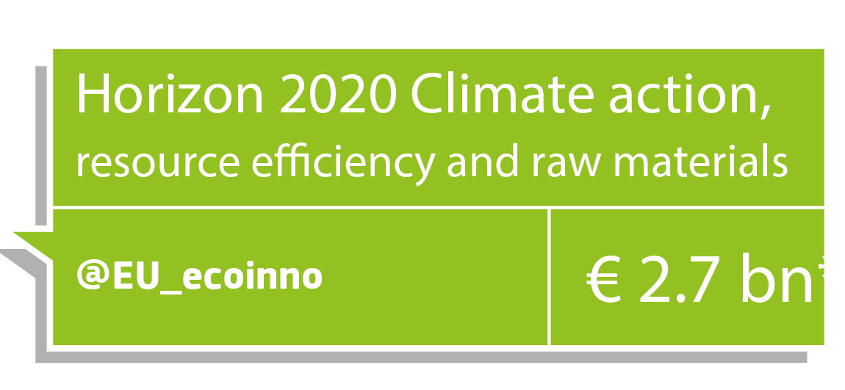
Notes:
One of the 6 Executive Agencies of the EC
The Executive Agency for Small and Medium-sized Enterprises (EASME) has been set-up by the European Commission to manage on its behalf several EU programmes.
Established in December 2003 as the Intelligent Energy Executive Agency (IEEA)
2007-2013: remit extended to the Competitiveness and Innovation Framework Programme (CIP) and Marco Polo
On 1st January 2014: EACI became EASME: the implementation of several programs were delegated to EASME
Today we are about 500 people in the agency and 50 people in our unit
The infographics present our different activities
4 fields
Green: Environment/Red: SMEs/Yellow: Energy/Blue: Maritime
Responsible for managing various programmes and activities :
1. Horizon 2020 Societal Challenge Climate Action, Environment, Resource Efficiency & Raw Materials.- € 2.7 bn between 2014 and 2020
Funding priorities for 2016 and 2017:
Climate services & decarbonisation
Circular economy
Raw materials
Cultural heritage for sustainable growth
Nature-based solutions
The Arctic dimension & earth observation
Research & innovation, innovation, and coordination & support projects – normally consortia of at least 3 partners in 3 different countries
2. LIFE € 3.1 bn between 2014 and 2020
The LIFE programme is the EU's funding instrument for the environment and climate action. The general objective of LIFE is to contribute to the implementation, updating and development of EU environmental and climate policy and legislation by co-financing projects with European added value.
LIFE focuses on preserving our natural capital, fostering green growth and the circular economy in Europe and supporting breakthrough actions in climate change adaptation and mitigation.
Priorities:
Nature & Biodiversity
Environment & Resource Efficiency
Environmental Governance & Information
Climate Change Mitigation
Climate Change Adaptation
Climate Governance and Information
3. SME INSTRUMENT - € 3.1 bn between 2014 and 2020
SME Instrument supports and invests in highly innovative, potentially disruptive businesses with global ambitions. SME Instrument is divided into phases:
Phase 1. Concept & Feasibility Assessment Idea to concept (6 months) > €50 000 in funding
Phase 2. Demonstration, Market Replication, R&D Concept to Market-Maturity (1-2 years) > from € 0.5 to € 2.5 million
Phase 3. Commercialisation Prepare for Market Launch > extensive support, training, mentorship and facilitating access to risk finance
4. European Maritime and Fisheries Fund- € 0.34 bn between 2014 and 2020
The EMFF is the financial instrument that will help deliver the objectives of the reformed Common Fisheries Policy (CFP) and that will support the implementation of the EU Integrated Maritime Policy (IMP
EMFF is the fund for the EU's maritime and fisheries policies for 2014-2020 The fund:
Helps fishermen in the transition to sustainable fishing
Supports coastal communities in diversifying their economies
Finances projects that create new jobs and improve quality of life along European coasts
Makes it easier for applicants to access financing
5. LEGACY EASME continues to manage two legacy programmes:
Intelligent Energy Europe offered help to organisations willing to improve energy sustainability €390 million between 2007 and 2012 IEE latest projects run until 2017
CIP Eco-innovation supported SMEs to bring innovative sustainable & resource-efficient products & services into the market. €200 million between 2008 and 2013 About 150 projects still running (last to finish in 2017)
6. Horizon 2020 Energy Efficiency € 0.8 bn between 2014 and 2020
Horizon 2020 Energy Challenge supports the transition to a secure, clean and efficient energy system for Europe. The calls 2016-2017 provide support for innovation through:
Research and demonstration of more energy-efficient technologies and solutions
Market uptake measures to remove market and governance barriers by addressing financing, regulations and the improvement of skills and knowledge
7. Fast Track to Innovation (FTI)- € 200 million between 2015 and 2016
The FTI pilot provides funding for bottom-up proposals for close-to-market innovation activities in any area of technology or application to any size companies. The aim is:
Reduce time from idea to market
Stimulate the participation of first-time applicants to EU research funding
Increase private sector investment in research and innovation
8. COSME 2.3 bn between 2014 and 2020
COSME is an EU programme for the Competitiveness of Small and Medium-sized Enterprises (SMEs). A significant part of the COSME programme is dedicated towards financial instruments managed by the European Investment Fund (EIF) under a European Commission mandate.
COSME is a programme for competitiveness of enterprises and SMEs in Europe. COSME helps SMEs by supporting:
Access to finance
Access to markets
Entrepreneurship and entrepreneurial culture
Better framework conditions for enterprises
9. Enterprise Europe Network (EEN)
The Network helps ambitious SMEs innovate and grow internationally It advises SMEs on:
International markets
Access to finance or funding
Finding a commercial partner abroad
Taking your innovation to market
10. Other SME support programmes
Horizon 2020 INNOSUP
Calls for proposals and tenders are elements of a broader action to develop the ecosystem of innovation support to SMEs in Europe
Actions are designed to provide opportunities to Member States and regions to enhance their services
Identification, further development and dissemination of skills and expertise among SMEs
Intellectual property:
Intellectual property right helpdesks
INNOVACCESS – The European Network of National Intellectual Property Offices
European Maritime and Fisheries Fund Objectives:
Transition to sustainable fishing
Economic diversification of coastal communities
Job creation and quality of life improvement in coastal areas
Easier access to finance
Budget: €6,5 bn. 2014-2020
Legacy of IEE
Legacy of Eco-innovation
Programmes
Most of COSME, the EU programme for the Competitiveness of Enterprises and Small and Medium-sized Enterprises (SMEs), including Enterprise Europe Network (EEN), Your Europe Business;
Part of Horizon 2020, the EU Framework Programme for Research and Innovation, and in particular:
Part II 'Industrial leadership':
Innovation in SMEs (including the European IPR Helpdesks, INNOVACESS and and Peer learning for innovation agencies)
The Sustainable Industry Low Carbon Scheme (SILC II)
part of the Leadership in Enabling and Industrial Technologies
INNOSUP
Part III 'Societal challenges':
The Energy Efficiency part of the challenge ‘Secure, Clean and Efficient Energy’;
The calls for proposals in the fields of waste, water innovation and sustainable supply of raw materials under the challenge ‘Climate action, Environment, Resource Efficiency and Raw Materials’
The SME instrument
Fast Track to Innovation (FTI) Pilot
Part of the EU programme for the Environment and Climate action (LIFE)
Part of the European Maritime and Fisheries Fund (EMFF)
The legacy of the Intelligent Energy – Europe programme and the Eco-innovation initiative
The EASME also organises the EU Sustainable Energy Week (EUSEW)

Slide 6
H2020 - Societal challenges
Health, demographic change and wellbeing | 7 472
Food security, sustainable agriculture and forestry, marine and maritime and inland water research and the Bioeconomy (+Blue Growth calls) | 3 851
Secure, clean and efficient energy * | 5 931
Smart, green and integrated transport | 6 339
Climate action, environment, resource efficiency and raw materials | 3 081
Inclusive, innovative and reflective societies | 1 310
Secure societies | 1 695
Science with and for society | 462
Spreading excellence and widening participation | 816
Additional funding for nuclear safety and security from the Euratom Treaty activities (2014-2018)
Notes:
7 societal challenges – budgets expressed in million euro
Total SC budget = 30 billion euro = 38% of H2020 budget
EASME manages efficiency part of SC3 and SC5
SC 5: 3 billion Euro

Slide 7
SC5 - Climate Action, Environment, Resource Efficiency and Raw Materials
To achieve a resource – incl. water - efficient and
climate change resilient economy and society,
The protection and sustainable management of natural
resources and ecosystems,
A sustainable supply and use of raw materials,
in order to meet the needs of a growing global population within the sustainable limits of the planet's natural resources and eco-systems
Harnessing Earth/Ocean observation data- GEO
Notes:
The SC5 is managed in one unit of EASME, unit B2
Climate action and earth observation is managed in one sector – sector B2.2

Slide 8
Content
EASME
BG 10 links
Project implementation: key aspects + administrative, financial and legal issues
Looking forward

Slide 9
Call - Blue Growth - Demonstrating an ocean of opportunities - H2020-BG-2016-2017
four interlinked pillars:
Boosting innovation for emerging Blue Growth
Activities
2) Linking healthy oceans and seas with healthy people
3) The Arctic dimension
4) Valorising the Mediterranean Sea Basin
Notes:
BG 9 - An integrated Arctic observation system

Slide 10
Call - Blue Growth - Demonstrating an ocean of opportunities - H2020-BG-2016-2017
3) The Arctic dimension: the objective is to deepen knowledge and identify sustainable and innovative approaches to tackle the challenges that climate change is posing in the Arctic region and on a global scale. Climate change represents a risk but also opens opportunities. Sustainability issues in the Arctic must also consider indigenous communities and the use of traditional knowledge. Moreover, international scientific cooperation is necessary as, due to the complex logistical constraints, no single country can work on its own. The Arctic may become a test bed for sustainable innovation and science diplomacy.

Slide 11
Synergies with other projects/initiatives like the BG projects or …
BG-15-2014: European polar research cooperation:
EU-PolarNet
BG-8-2014: Developing in-situ Atlantic Ocean Observations for a better management and exploitation of the maritime resources
AtlantOS
BG-09-2016: An integrated Arctic observation system
INTAROS
BG-10-2016: Impact of Arctic changes on the weather and climate of the Northern Hemisphere
APPLICATE
BG-11-2017: The effect of climate change on Arctic permafrost and its socio-economic impact, with a focus on coastal areas
SC5-01-2014: Advanced Earth-system models
PRIMAVERA and CRESCENDO

Slide 12
… the GEO-related projects 2014-2015
SC5-16-2014: Making EO and Monitoring Data usable for ecosystem modelling and services ECOPOTENTIAL, SWOS
SC5-18a-2014: Coordinating European Observation Networks to reinforce the knowledge base for climate, natural resources and raw materials ConnectinGEO
SC5-15-2015: Strengthening the European Research Area in the domain of EO ERA-PLANET
SC5-18b-2015: Integrating North African, Middle East and Balkan Earth Observation capacities in GEOSS – GEOCRADLE
SC5-17-2015: Demonstrating the concept of 'Citizens‘ Observatories' GROW, SCENT, LANDSENSE, GROUNDTRUTH2.0

Slide 13
… the GEO-related projects 2016-2017
SC5-20-2016: European data hub of the GEOSS information system (Data access) NEXTGEOSS
SC5-18-2017: Novel in-situ observation
SC5-19-2017: Coordination of citizen observatories initiatives
… AND OTHERS
SFS-43-2017: EO services for the monitoring of agricultural production in Africa
SMEinst-11-2016-2017: Boosting the potential of small businesses in the areas of climate action, environment, resource efficiency and raw materials (inc. EO)
BG-12-2016: Towards an integrated Mediterranean Sea Observing System

Slide 14
11th GEO European Projects Workshop 2017
From 19th to 21st June 2017 in Helsinki
co-organised by the Finnish Meteorological Institute and the European Commission. Please book these dates in your calendars!
We will provide you more information about the venue, the programme and registration very soon. All the details on the workshop will also be found here https://ec.europa.eu/easme/en/11th-geo-european-projects-workshop-2017

Slide 15
Content
EASME
BG 10 links
Project implementation: key aspects + administrative, financial and legal issues
Looking forward

Slide 16
H2020 – Focus on Innovation
The successful exploitation of new ideas to produce tangible benefits, satisfying needs and wants
Technological or non-technological innovation
a system-wide transformation affecting the economic, social and environmental dimensions.
Integration of users in the process is crucial in a participatory approach through co-design, co-development and co-implementation.
Source: Dr. Eugene Sweeney Impact&Innovation in H2020, https://www.iprhelpdesk.eu/sites/default/files/events/04%20Preparing%20Proposals%20and%20Managing%20Projects.pdf
Notes:
Innovation is about satisfying needs and delivering benefits
Systemic innovation aims at responding to the societal challenge by obtaining a system-wide transformation affecting the economic, social and environmental dimensions.
Integration of users in the process is crucial in a participatory approach through co-design, co-development and co-implementation.
Innovation implies Exploitation of R&D results.
Innovation potential: How much benefit (innovation) can the project results potentially deliver?
Innovation management, which is to identify and exploit R&D results for innovation

Slide 17
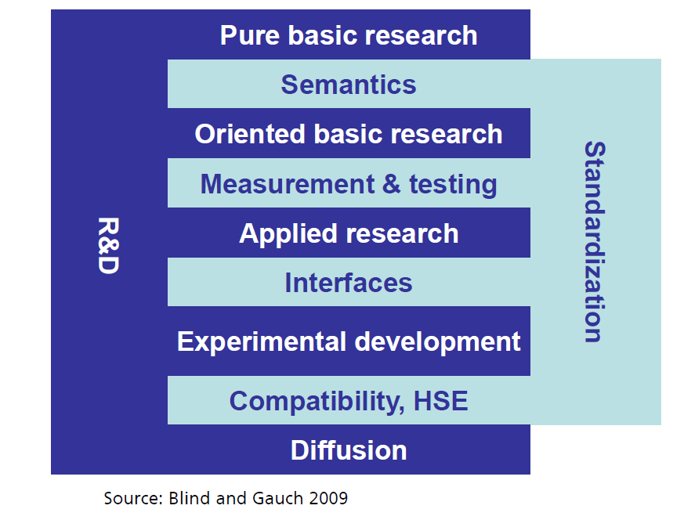
Standards - a major driver of innovation
Benefits:
worldwide trade
quality assurance
environmental protection
security
communication
Source: DIN study "Economic Benefits of Standardization", updated in 2011
Notes:
Standards are a major driver of innovation
Important for all levels of R&D, from basic research to experimental development and diffusion of the technology.
A study from the German DIN has shown multiple benefits of standards, economical, environmental.
greater economic growth than patents or licenses
create “markets”
Making project output sustainable

Slide 18
Standards
Where relevant
Link your project with ongoing standardization work
Involve standardisation partner (formal or informal)
http://www.cencenelec.eu/news/publications/Publications/Standards_Horizon2020.pdf
Notes:
Where relevant for your project it is important to link up with ongoing standardisation work, e.g. through links with Technical Committees, and to involve a standardisation partner, which could also be a member of a standardisation organisation such as CEN
It could also be informal standardisation organisations such as OGC
CEN-CENELEC has produced a guidance on how to integrate standards in H2020 proposals.
Usually the call description gives a clue as to whether standardisation is a key issue for the call, but even when it's not mentioned in the topic description it could be relevant for your work.

Slide 19
Earth observation and spatial data
INSPIRE
"All activities related to Earth observation data and other spatial data should comply at best with and build upon the existing Infrastructure for Spatial Information in the European Community (INSPIRE)". (SC5 work programme introduction)
JRC: http://inspire.ec.europa.eu
OGC: www.opengeospatial.org/pressroom/marketreport/inspire
GEO – GEOSS
Follow the GEOSS Data Sharing Principles
Register data in the GEO data portal
Notes:
For Earth Observation and spatial data, the WP requires that projects comply with the INSPIRE directive
Open Geospatial Consortium (OGC) standards act to support the INSPIRE directive
Projects dealing with earth observation are also recommended to follow the GEOSS data sharing principles and to register data in the portal
Global Earth Observation System of Systems (GEOSS).
The ‘GEOSS Portal’ offers a single Internet access point for users seeking data, imagery and analytical software packages relevant to all parts of the globe. It connects users to existing data bases and portals and provides reliable, up-to-date and user friendly information

Slide 20
Open Access
Open access to scientific publications (GA Article 29.2)
Each beneficiary must ensure open access (free of charge, online access for any user) to all peer-reviewed scientific publications relating to its results
Self-archiving: in online repository (depositing)
Open access publishing
Support: www.openaire.eu
Notes:
open acces is one of the major policies in H2020, = cross cutting issue -> in order to increase the impact of project results
All H2020 projects are obliged to provide OA to peer reviewed publications arising from project funding
OA = free of charge online access for any user
Open access to publications - two main routes towards OA
Self-archiving: archiving in online repository before or after publication by the author ("Green OA"), often after embargo period set by the (non-OA) publisher (max 6 months)
OA publishing: immediate in OA mode when published ("Gold OA"), publishing costs can be reimbursed
For Horizon 2020, providing open access to publications in funded projects is an obligation for all grants.

Slide 21
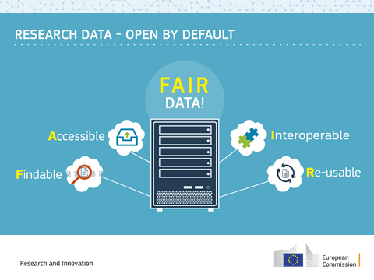
Open Access
Open access to research data (GA Article 29.3 )
Open Research Data applies by default to whole H2020
Notes:
A novelty in Horizon 2020 is the Open Research Data Pilot which aims to improve and maximize access to and re-use of research data generated by projects.
Applies to research data:
Underlying data for publications – metadata = data describing research data
Eg raw data
Requirements:
Data repository: thematic or institutional -> see openaire
Measures to access: attach a Creative Commons License (= a public copyright license) to data deposited
Info: eg algorithms, software code, ….
required to develop a Data Management Plan (DMP) by month 6:

Slide 23
Open Access
Open access to research data (GA Article 29.3 )
Requirements in GA:
deposit data in a research data repository
take measures to make it possible for third parties to access, mine, exploit, reproduce and disseminate — free of charge for any user
provide information about tools and instruments at the disposal of the beneficiaries and necessary for validating the results
Notes:
A novelty in Horizon 2020 is the Open Research Data Pilot which aims to improve and maximize access to and re-use of research data generated by projects.
Applies to research data:
Underlying data for publications – metadata = data describing research data
Eg raw data
Requirements:
Data repository: thematic or institutional -> see openaire
Measures to access: attach a Creative Commons License (= a public copyright license) to data deposited
Info: eg algorithms, software code, ….
required to develop a Data Management Plan (DMP) by month 6:

Slide 24
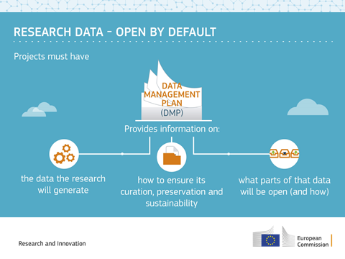
Open Access
Open access to research data (GA Article 29.3 )
data management plan (DMP) = deliverable at M6
Support
http://ec.europa.eu/research/participants/data/ref/h2020/grants_manual/hi/oa_pilot/h2020-hi-oa-pilot-guide_en.pdf
http://ec.europa.eu/research/participants/docs/h2020-funding-guide/cross-cutting-issues/open-access-dissemination_en.htm
Notes:
A novelty in Horizon 2020 is the Open Research Data Pilot which aims to improve and maximize access to and re-use of research data generated by projects.
Applies to research data:
Underlying data for publications – metadata = data describing research data
Eg raw data

Slide 25
Communication in H2020
Legal obligation to promote project (Art. 38.1.1)
The beneficiaries must promote the action and its results, by providing targeted information to multiple audiences (including the media and the public) in a strategic and effective manner". […]
Before engaging in a communication activity expected to have a major media impact, the beneficiaries must inform the Agency (see Article 52).

Slide 26
Communication in H2020
Acknowledgement of EU funding (Art. 38.1.2)
Use EU emblem
High-resolution emblems are available here: http://europa.eu/about-eu/basic-information/symbols/flag/
Use text as indicated in GA
"This project has received funding from the European Union’s Horizon 2020 research and innovation programme under grant agreement No [number]."

Slide 27
Communication in H2020
Inform the Agency about your communication activities, we can help you spread the word.
Check out our Communication Toolkit for more information
60-minute workout to increase the communication impact of your project - webinar

Slide 28
Events Organized by EASME/EC
Arctic Workshop in Brussels, 29 and 30 March 2017.
GEO European Project Workshop, Helsinki, 19-21 June
Climate Modelling Workshop, Brussels, May - June

Slide 29
Project timeline and payments
Start of project
01/12/2016
End of 1st reporting period
31/05/2018
End of 2nd reporting period
30/11/2019
End of 3d reporting period
28/02/2021
Pre-financing € 8,261,368.95
Submitted max. 60 days after the end of the reporting period (M18)
Paid within max. 90 days of receipt of 1st periodic report
Submitted max. 60 days after the end of the reporting period (M36)
Paid within max. 90 days of receipt of 2nd periodic report
Submitted max. 60 days after the end of the reporting period (M51)
Paid within max. 90 days of receipt of 3d periodic report

Slide 30
Periodic and continuous reporting
Periodic and final reports to EC, payment requests
3 reporting periods (18-36-60)
Article 20 (GA)
Continuous submission of deliverables, milestones, etc.
Throughout the action
Article 19 (GA)
Notes:
In H2020 there is a periodic and continuous reporting…
For the periodic, 3 periods have been established according to the duration of the project – M18, M36, M60
Given the fact there will be a long reporting period (of 24 months), you will be requested to inform the Agency each year of the cumulative expenditure incurred by the beneficiaries from the start date of the action. This information is required for the Commission’s accounting purposes and will not be used to calculate the final grant amount. Please enclosed the template of the report you will have to fill in. It means that you have to add 5 deliverables in the WP 8 (report on cumulative expenditure incurred).

Slide 31
Financial reporting
Keep records and supporting documents (Art. 18)
Costs must be actually incurred by the beneficiary: i.e. only what is in the beneficiaries (or TP) books is eligible
Records for personnel costs – Timesheets (except for staff working full time for the project)
Webinar with FO on details can be provided.
Find out more in annotated Model Grant Agreement :
http://ec.europa.eu/research/participants/data/ref/h2020/grants_manual/amga/h2020-amga_en.pdf

Slide 32
Climate-friendly Climate Research
Adhere to the principles of sustainability also in the way you run the project.
Reduce the carbon footprint of the research system
For example by organizing "green meetings", teleconferences instead of regular meetings, etc
Find out more:
http://www.jpi-climate.eu/jpi-themes/climatefriendlyclimateresearch

Slide 33
Submission of deliverables
Step 1
Log into the Participant Portal when a notification is received
Step 2
Complete the deliverable
Step 3
Submit the deliverable to the EC
Step 4
The EU Services assess the deliverable
Notes:
Note: uploaded deliverables can be deleted and replaced directly. Once a deliverable has been submitted, though, it can't be replaced without an intervention from the project officer: the officer has to reject ('ask for a revision') the deliverable. After this step, the deliverable will be in the 'pending' status again, and you will be able to upload a new version.
Good practice: in case a deliverable is delayed, always consult the project adviser and provide justification

Slide 34
Submission of reports
Step 1
Log into the Participant Portal when a notification is received
Step 2
Complete Financial Statement and contribute to the Technical Part of the Periodic Report; E-sign and submit Financial Statements to the Coordinator
Step 3
The Coordinator approves the elements of the Periodic Report & submits to the EU
Step 4
The EU Services review the report and accept or reject it (90 days)
Step 5
Interim Payment

Slide 35
Summing Up
Seek collaborations
Transparent and regular communication with the Project Adviser
Communicate your action through targeted information to multiple audiences and keep us informed
Acknowledge EU support
Timely high quality deliverables
Keep records
Achieve significant impact!

Slide 36
Content
EASME
BG10 links
Project implementation: administrative, financial and legal issues
Looking forward

Slide 37
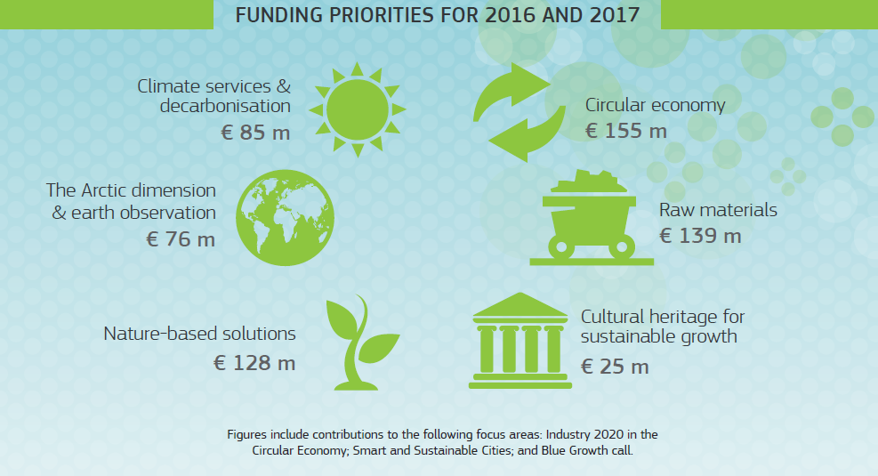
More info on Horizon 2020: ec.europa.eu/programmes/horizon2020
@EU_ecoinno ec.
Notes:
Horizon 2020 Societal Challenge Climate Action, Environment, Resource Efficiency & Raw Materials
Research & innovation actions that establish new knowledge or develop more resource-efficient technologies
and solutions. EU funding rate: 100%
Innovation actions that demonstrate the viability of new technologies and solutions or support their first deployment in the market. EU funding rate: 70%
Coordination & support actions that improve skills, mobilise large-scale investments or facilitate EU policy
implementation. EU funding rate: 100%
In addition, Horizon 2020 supports small businesses in the areas of climate action, environment, resource
efficiency & raw materials via SME Instrument € 52 m.

Slide 38
WP 2018-2020
April 2016 – Stakeholders' consultation
Dec 2016-June 2017 – WP drafting
End of 2017 – WP adoption
More info on the SC5 WP preparation https://ec.europa.eu/programmes/horizon2020/en/climate-action-environment-resource-efficiency-and-raw-materials-work-programme-2018-2020#Article
SC5 – Infoday – 9/11/2017

Slide 39
Become an independent expert
25% new experts
Read excellent proposals
Network with fellows
Academia
Private sector / innovation agencies
Local / national authorities / agencies
Call for experts:
http://ec.europa.eu/easme/en/call-experts-climate-action-environment-resources-management

Slide 40
Thank you for your attention! Questions?
Fabio DALAN
Project Adviser
EASME, European Commission Unit B2: H2020 Environment and Resources +32 2 29 52579
name.surname@ec.europa.eu
Guillaume DECANIS
Financial Officer
EASME, European Commission Unit C1: Finance H2020 +32 22 98 5018
name.surname@ec.europa.eu

