Slide 1
WP5
Developing and Valuing Climate and Information Services
Lead: Mark R. Payne (Technical University of Denmark) and Kathrin Stephen (IASS
Presenter: Mark R. Payne (Technical University of Denmark)

Slide 3
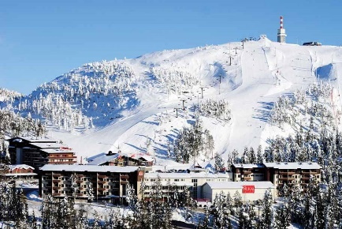
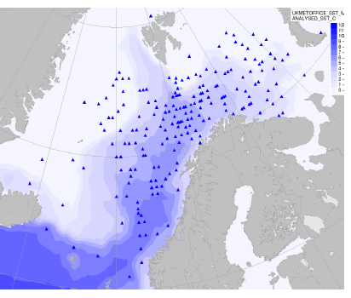
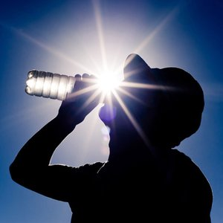
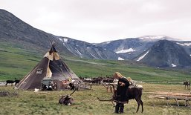
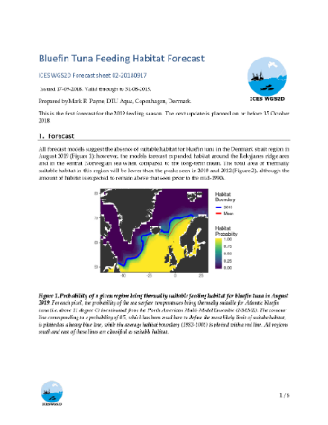
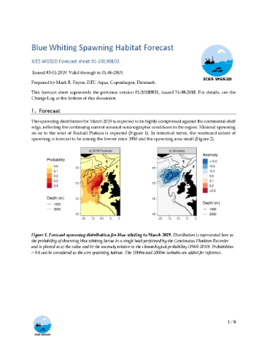
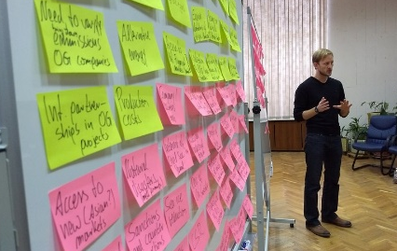
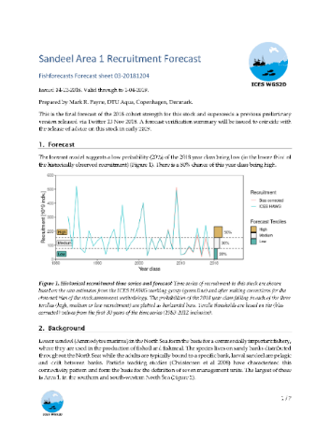
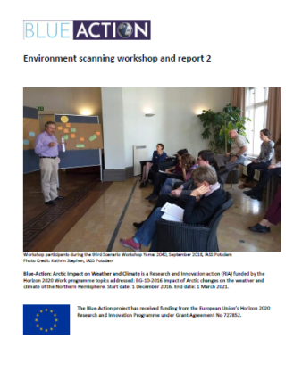
Our Climate and Information Service Case Studies
Tourism
Shipping
Heatwaves
Fisheries
Arctic Devel.Scenarios

Slide 4
A Common(ish) Approach
Identification of end-user-relevant climate services
Development of products in collaboration with end-users
Evaluation/Valuation of products preferably in economic terms
Dissemination to the wider sector

Slide 5
WP5 Developing and Valuing Climate and Information Services: Partners and Stakeholders

Slide 6
Thank you!
The Blue-Action project has received funding from the European Union’s Horizon 2020 research and innovation programme under grant agreement No 727852
Twitter: @BG10Blueaction
Zenodo: https://www.zenodo.org/communities/blue-actionh2020
www.blue-action.eu

