Slide 1
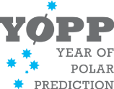
H2020 Blue-Action:
Arctic Impact on Weather and Climate
What?
Blue-Action is a research and innovations project funded by the European Union’s Horizon 2020 programme
Responded to the Blue-Growth BG-10-2016 Arctic call
Why?
To actively improve our ability to describe, model, and predict Arctic climate change and its impact on Northern Hemisphere climate, weather and their extremes.
To deliver valuated climate services of societal benefit.
To make a significant contribution to YOPP, AR6 and C3S.
How?
Through synthesising observations
Assessing model performance
Designing and performing coordinated multi-model sensitivity experiments,
Developing innovative initialization techniques.

Slide 2
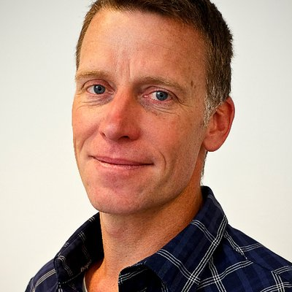
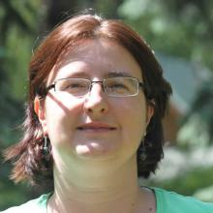
H2020 Blue-Action:
Arctic Impact on Weather and Climate
Who are we?
We bring together experts from 40 organizations in 17 countries on three continents
We work directly with local communities, businesses operating in the Arctic and industrial organizations, local authorities and maritime industries.
Blue-Action is coordinated by Steffen M. Olsen (DMI) and Daniela Matei (MPI).
When?
Blue-Action started 1 December 2016 and is a 4-year project (51 months).
The Kick-Off is now, in the Harnack-Haus, Berlin 18-20 January 2017!

Slide 3
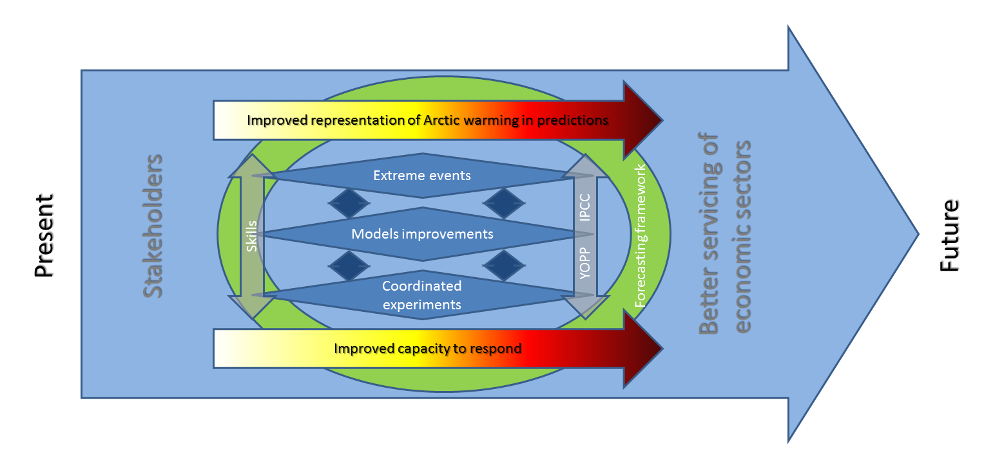
Overarching Objective
- The concept
To actively improve our ability to describe, model, and predict Arctic climate change and its impact on Northern Hemisphere climate, weather and their extremes, and to deliver valuated climate services of societal benefit.

Slide 4
The project is expected to:
Improve capacity to predict the weather and climate of the Northern Hemisphere, and make it possible to better forecast of extreme weather phenomena;
Improve the capacity to respond to the impact of climatic change on the environment and human activities in the Arctic, both in the short and longer term;
Improve the capacity of climate models to represent Arctic warming and its impact on regional and global atmospheric and oceanic circulation;
Improve the uptake of measurements from satellites by making use of new Earth observation assets;
Lead to optimized observation systems for various modelling applications;

Slide 5
The project is expected to:
.. continued
Contribute to a robust and reliable forecasting framework that can help meteorological and climate services to deliver better predictions, including at sub-seasonal and seasonal time scales;
Improve stakeholders’ capacity to adapt to climate change;
Contribute to better servicing the economic sectors that rely on improved forecasting capacity;
Contribute to the Year of Polar Prediction (YOPP) and IPCC scientific assessments, and to the Copernicus Climate Change (C3S) services.
Improve the professional skills and competences for those working and being trained to work within this subject area.
Contribute to implementing the Transatlantic Ocean Research Alliance.

Slide 6
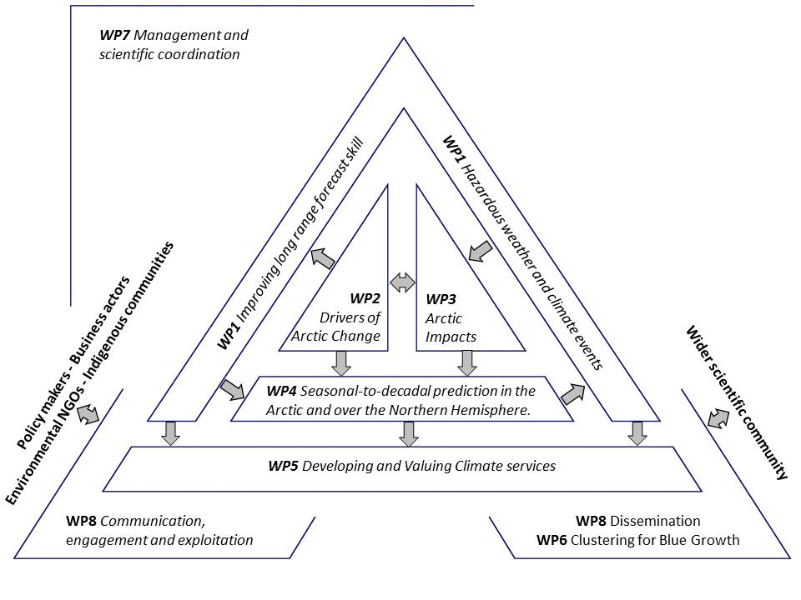
Project Structure

Slide 7
Internal Governance
General Assembly is the ultimate decision making body. This will be chaired by the Coordinator and will consist of all partner organizations.
Steering Committee will be the supervisory body ensuring successful execution of the project, and will be accountable to the General Assembly. This will be chaired by the Coordinator.
Coordinator is responsible for the overall coordination of the project and will act as the point of contact for the European Commission (EC). The Coordinator has ultimate responsibility for ensuring that the project delivers what is expected and oversees the scientific content of the project and ensuring that all work packages are contributing to the outcomes and scientific excellence.
Project Office will conduct the routine management of on behalf of the General Assembly.
Work Package Leaders and their co-leaders have a responsibility to ensure delivery of their Work Package objectives, deliverables and milestones, working closely with the Coordinator to support the outcomes of the project.

Slide 8
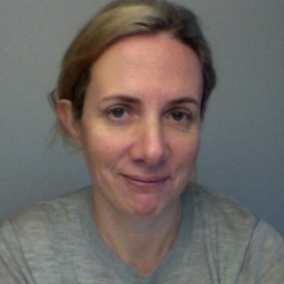
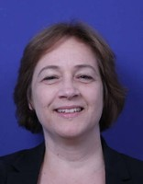
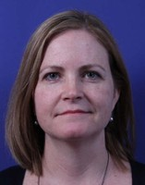
The project office at DMI
Steffen Olsen Chiara Bearzotti
Coordinator Project manager
Katrine Sandvad Vivian Henningsen
Financial manager Secretary
Collect from Vivian a signed version of the CA!

Slide 9
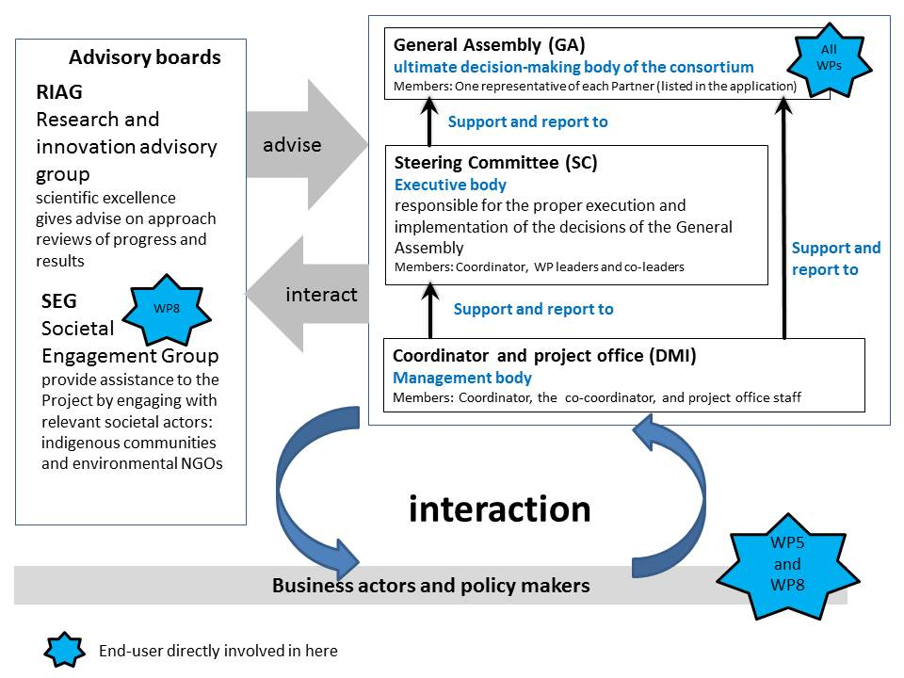
Governance
Notes:
Warm arctic cold continets. Temeperatures on the NP at the freezing point

Slide 10
External advisory boards:
Research and Innovation Advisory Group (RIAG)
Tasks
provide guidance and support regarding the scientific quality and innovation
provide high, strategic level guidance, support, and advice on innovation management issues, especially with respect to the scientific relevance and transferability of products and tools
help maintain scientific excellence in the program
perform yearly internal reviews of progress and results from an independent, external perspective.
help promote the project activities beyond the project own scientific community
Composition: Darlene Langlois, Guy Brasseur, Mike Steele, Francis Zwiers, Jean-Noel Thepaut (Carlo Buentempo) and Tom Reynolds

Slide 11
External advisory boards:
Societal Engagement Group (SEG)
Tasks
Open up a dialogue between the represented communities and the project, for the project to receive critical feedback on development and results and how these can provide a feed from the communities’ existing agendas.
Providing an additional channel of communication for improve usage of data and information by the communities for enhancing climate adaptation.
Composition: Liisa Holmberg (Saami Education Institute), Lene Kielsen Holm (Greenland Institute for Natural Resources), a representative of the Inuit Circumpolar Council (ICC), Jon Burgwald (Greenpeace), a representative of BirdLife International.
Notes:
We have decided not to involve the SEG in the kick-off

Slide 12
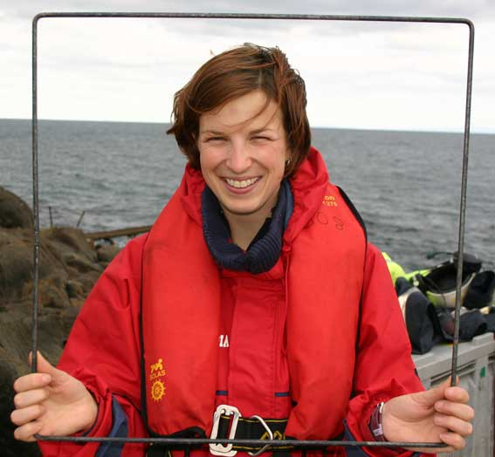
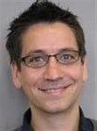
WP8: Communication, Dissemination, Engagement and Exploitation
Dr Raeanne Miller
(WP8 lead)
SAMS Research Services Ltd (SRSL)
Peter Vangsbo Normann (WP8 co-lead)
Climate-KIC Nordic

Slide 13
WP8 ideas for a project logo

Slide 14
Enjoy the networking lunch!
www.Blue-Action.eu
Blue-Action
@BG10Blueaction

Slide 15
Clustering for Blue Growth
Blue-Action intends to establish a strong clustering activity with the European and international scientific communities focusing on Blue Growth/Arctic impacts and more specifically with:
projects funded by the Blue Growth strategy under current and earlier calls;
projects funded under other parts of the Horizon 2020 programme relevant for the Blue Growth strategy implementation;
Initiatives such as YOPP, PPP, Copernicus, and projects funded by the Belmont Forum/JPI Climate calls.
Main outcome will be a series of joint activities for allowing the exchange of data and results between the scientific communities beyond the project.

Slide 16
Clustering
EU-PolarNet
Connecting science with society
AtlantOS
Optimising and Enhancing the Integrated Atlantic Ocean Observing Systems
AORAC-SA
Atlantic Ocean Research Alliance
CERES
Climate change and European Aquatic Resources
Projects under the work programme 2016-2017 especially
INTAROS (BG9, Stein Sandven)
Integrated Arctic Observing System
APPLICATE (BG10)
Advanced Prediction in Polar regions and beyond

Slide 17
Clustering
Joint workshops (“Mapping the gaps” events)
What are the optimal methods to initialize ocean heat content, snow cover and sea ice to and to represent the initial uncertainty in prediction systems?
How is sub-seasonal to seasonal predictive skill modulated by decadal climate variability?
Are predictive systems and the observational network adequate to fully exploit the predictive potential related to arctic freshwater storage and release through ocean linkages?
How can long-term predictions be used in innovative fisheries and ecosystem services?
How will improved representation of small-scale processes of particular relevance for the Arctic affect the two-way linkages between the Polar Regions and lower latitudes?

Slide 18
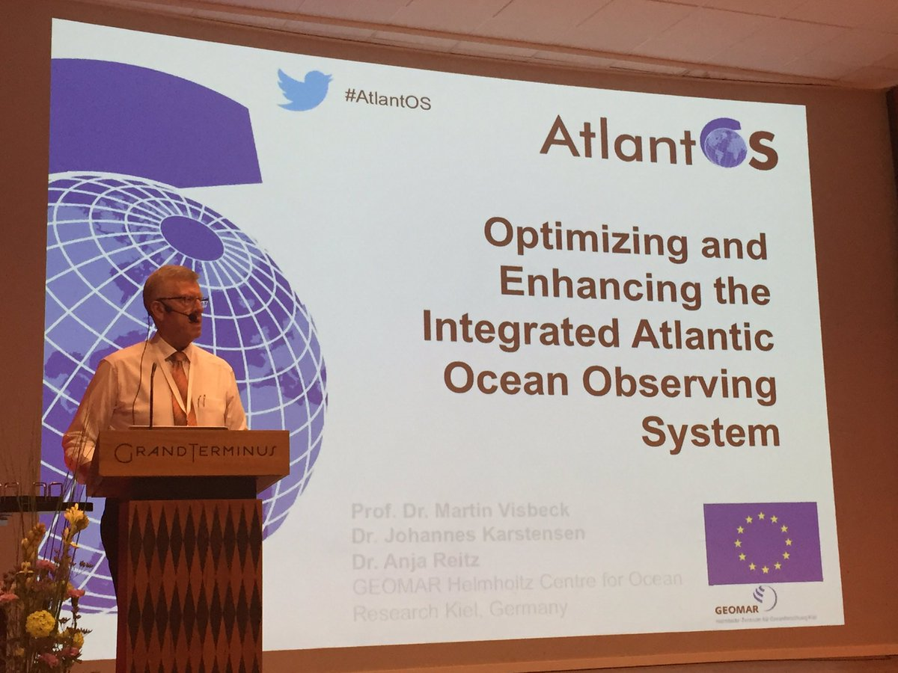
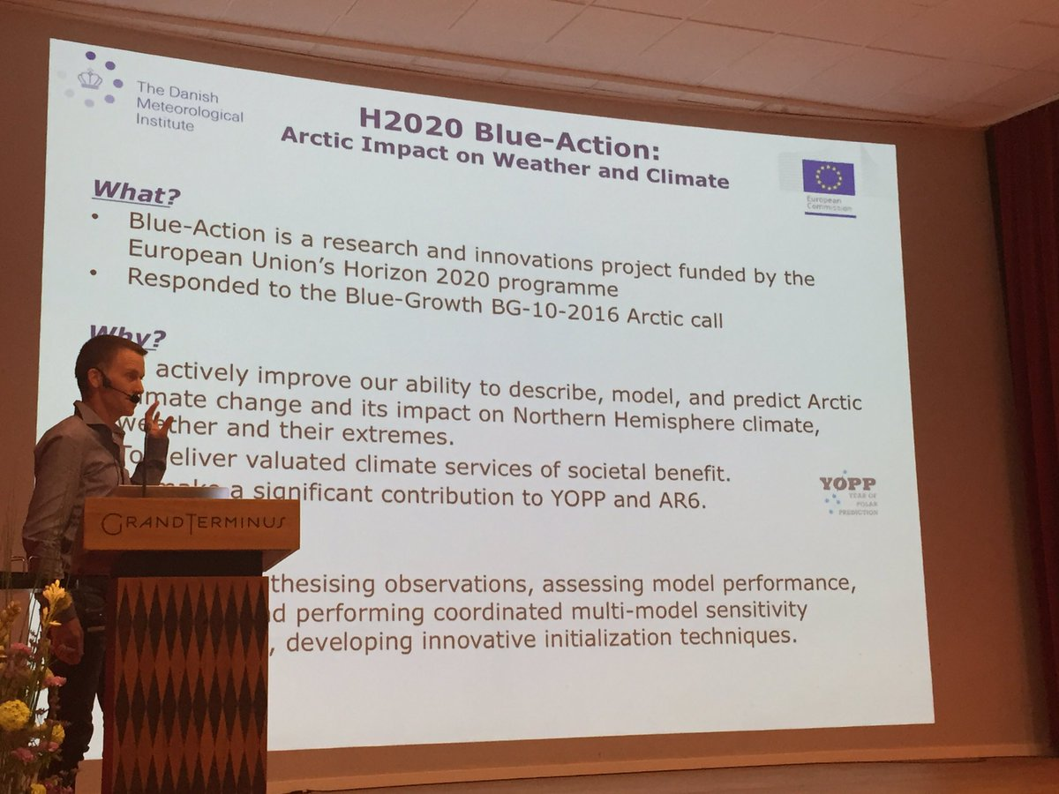
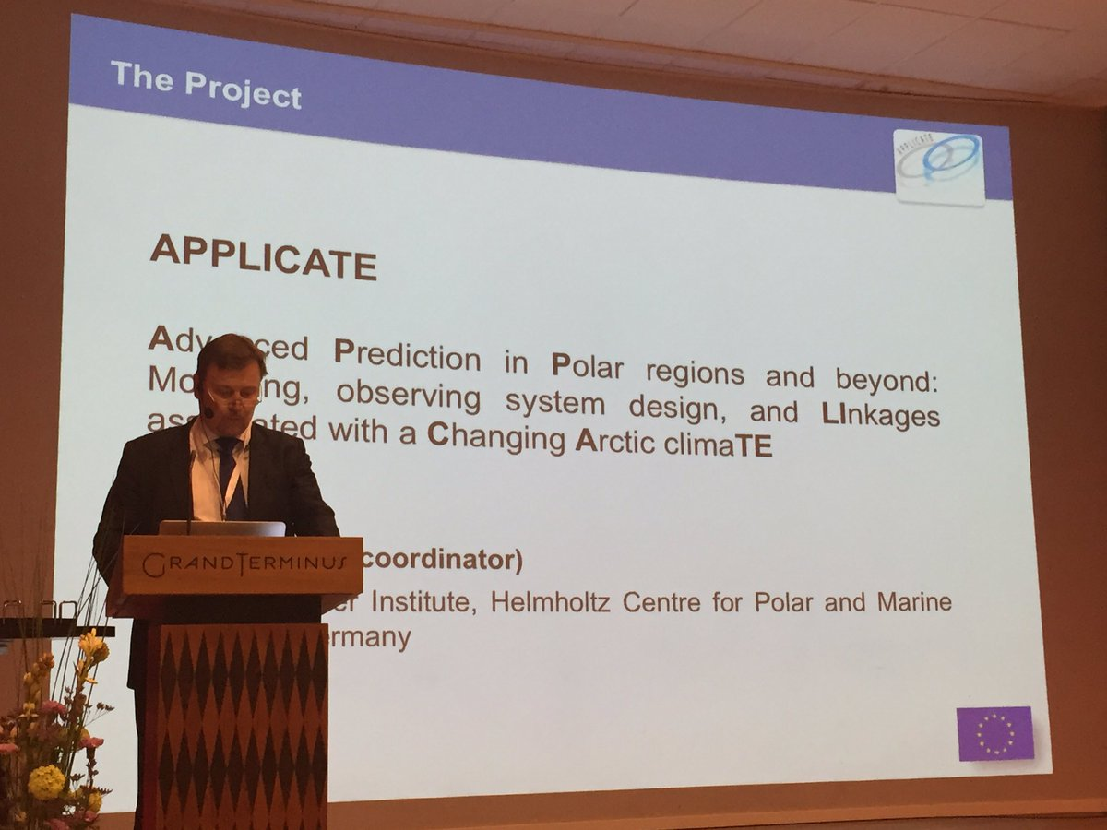
Clustering – at the INTAROS Kick-Off

