Slide 1
Joint Programming Initiative Healthy and Productive Seas and Oceans
Presentation for Blue Action project,
January 2017
Mrs Jacky Wood
Deputy Director JPI Oceans Secretariat
Email jkw@rcn.no
http://www.jpi-oceans.eu/

Slide 2
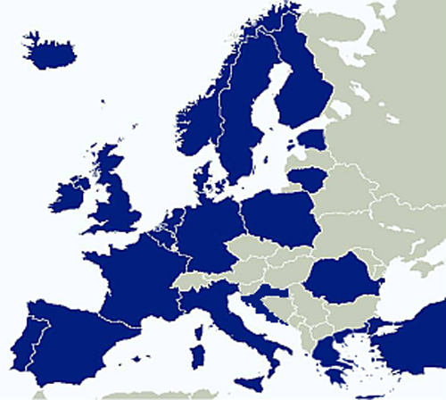
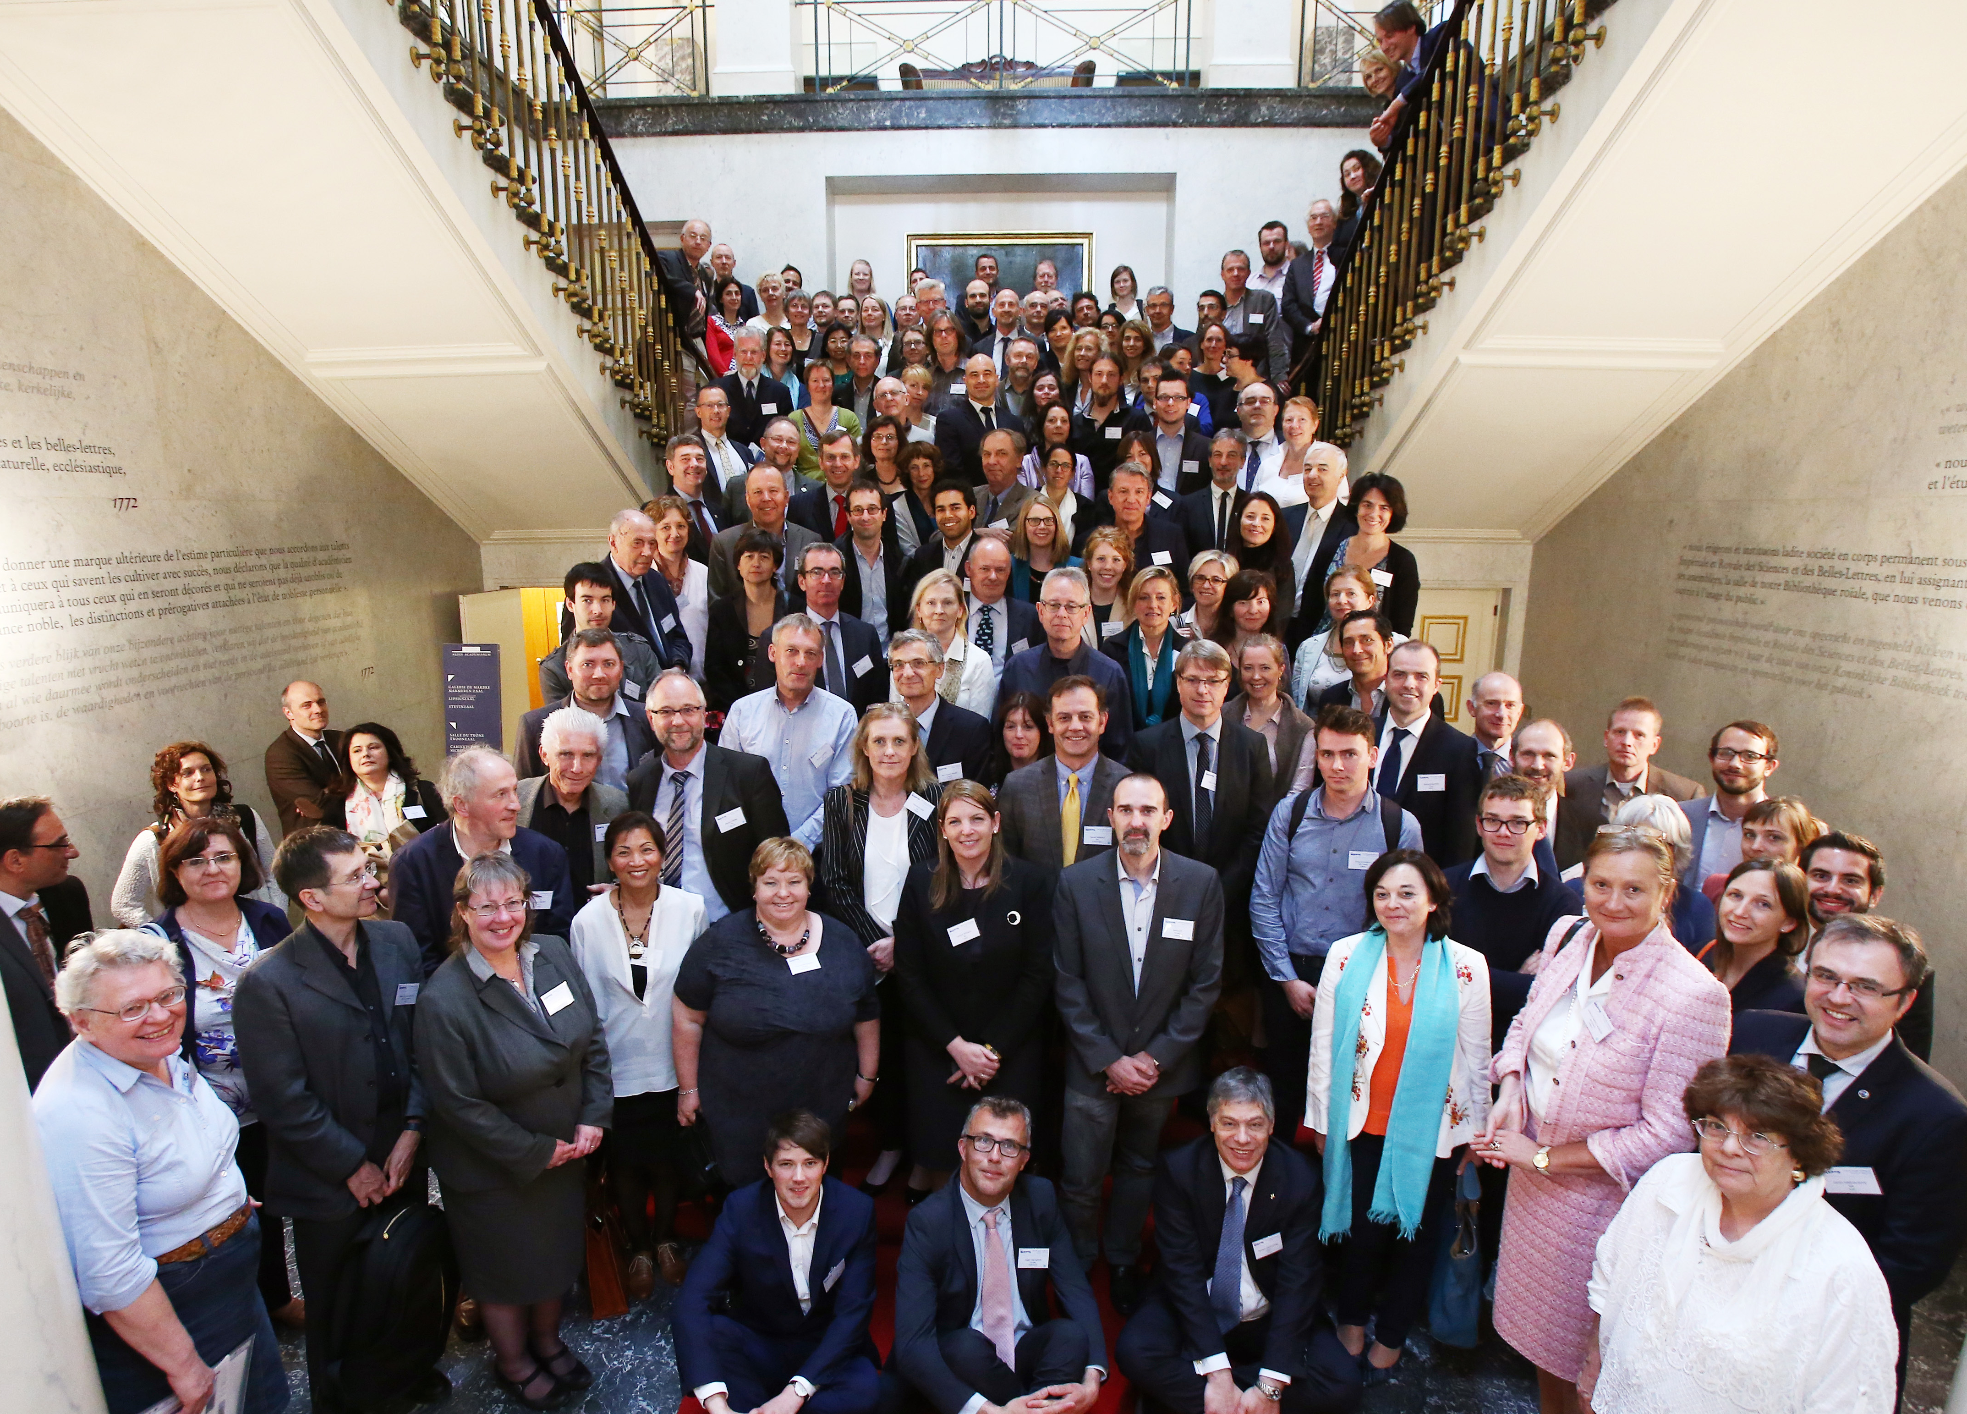
What is JPI Oceans?
Intergovernmental process, providing a long-term integrated approach to marine and maritime Research and Technology Development.
Strategic alignment and coordination of national R&D investments and best use of other funding streams
Addressing societal challenges of our seas and oceans that cannot be solved solely on the national level.
22 countries (Ministries/Research funders) plus Commission as a non-voting member
Joint actions, involving countries willing to participate
Wide range of interventions (not just joint calls)
Adding value, avoiding duplication
Wider International cooperation case-by-case

Slide 3
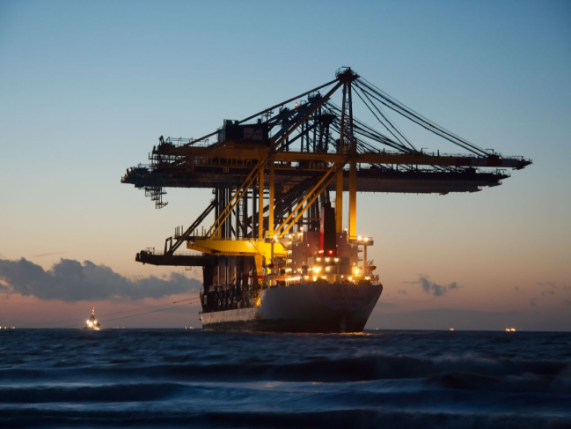
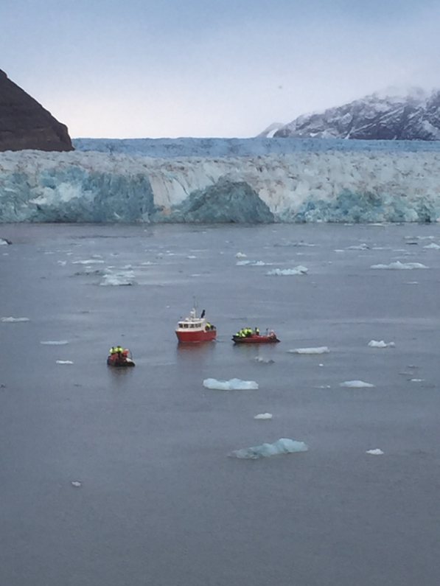
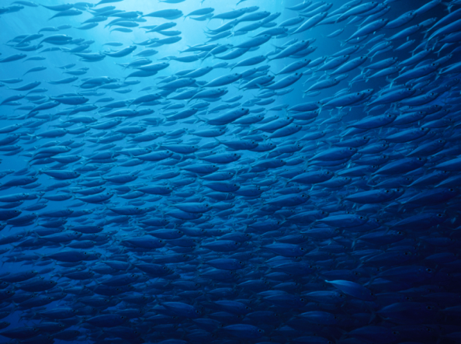
3 major goals:
Knowledge based sustainable
Marine and Maritime economy
Optimise the response to climate change
and its impacts
Legal obligations and governance
Good environmental status of the seas

Slide 4
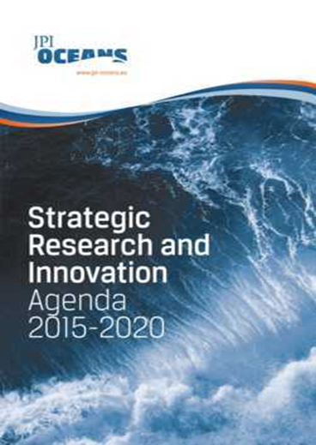
Strategic Research and Innovation Agenda
Exploring Deep Sea Resources
Technology and Sensor Developments
Science Support to Coastal and Maritime Planning and Management
Linking Oceans, Human Health and Wellbeing
Interdisciplinary Research for Good Environmental Status
Observing, Modelling and Predicting Oceans State and Processes
Climate Change Impact on Physical and Biological Ocean Processes
Effects of Ocean Acidification on Marine Ecosystems
Food Security and Safety Driving Innovation in a Changing World
Use of Marine Biological Resources through Development and Application of Biotechnology
http://jpi-oceans.eu/ news-events/ news/jpi-oceans-sria-now-available

Slide 5
Implementation Step–by–Step approach
- Flexibility - Relevance - Learning
Agree
Lead country and
Expression of
interests
Assessment
MB & StAB
Agreement
of next
Implementation
Step
Factsheets
from Iplan menu
Identifying and
involving
Users & Producers
Implementation
Step 1
Adaptation
&
Implementation
Step 2
Breakoff
Point

Slide 6
Pilot Action: Microplastics
Why Microplastics?
Plastics and microplastics are persistent, ubiquitous and have a high potential to cause physical harm and toxicological effect.
There are a variety of methodologies for identifying and quantifying plastics – leading to a lack of comparable data
Joint Research
10 JPI Oceans member countries (BE, DE, ES, FR, IE, IT, NL, NO, PT, SE) issued a call for proposals in 2015 focusing on:
Validation and harmonisation of analytical methods (inter-laboratory study)
Identification and quantification of microplastics
Eco-toxicological effects of microplastic – impact on marine organisms
Total budget of approx. 7.5m € from participating countries

Slide 7
Microplastics Projects
4 Projects started on 1 Dec 2015. Joint kick-off in Feb 2016 in Madrid:
BASEMAN – Defining Baselines and standards for Microplastics analyses in European Waters. Coordination: AWI, DE.
WEATHER-MIC: How microplastics weathering changes its transport, fate and toxicity in the marine environment. Coordination: UFZ Leipzig, DE.
PLASTOX – Direct and Indirect ecotoxicological impacts of microplastics and POPs on marine organisms. Coordination: SINTEF, NO.
EPHEMARE – Ecotoxociological effects of microplastics on marine ecosystems. Coordination: University of Vigo, ES.

Slide 8
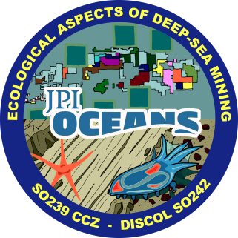
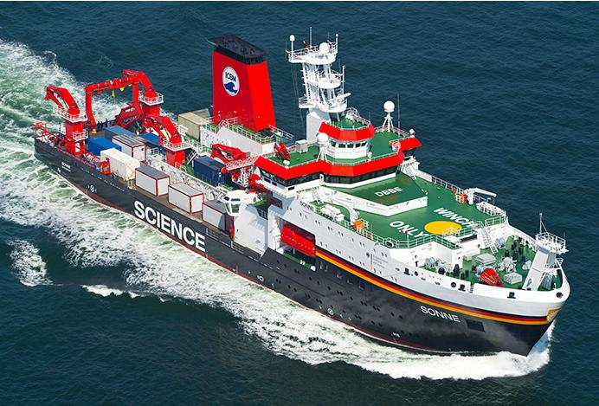
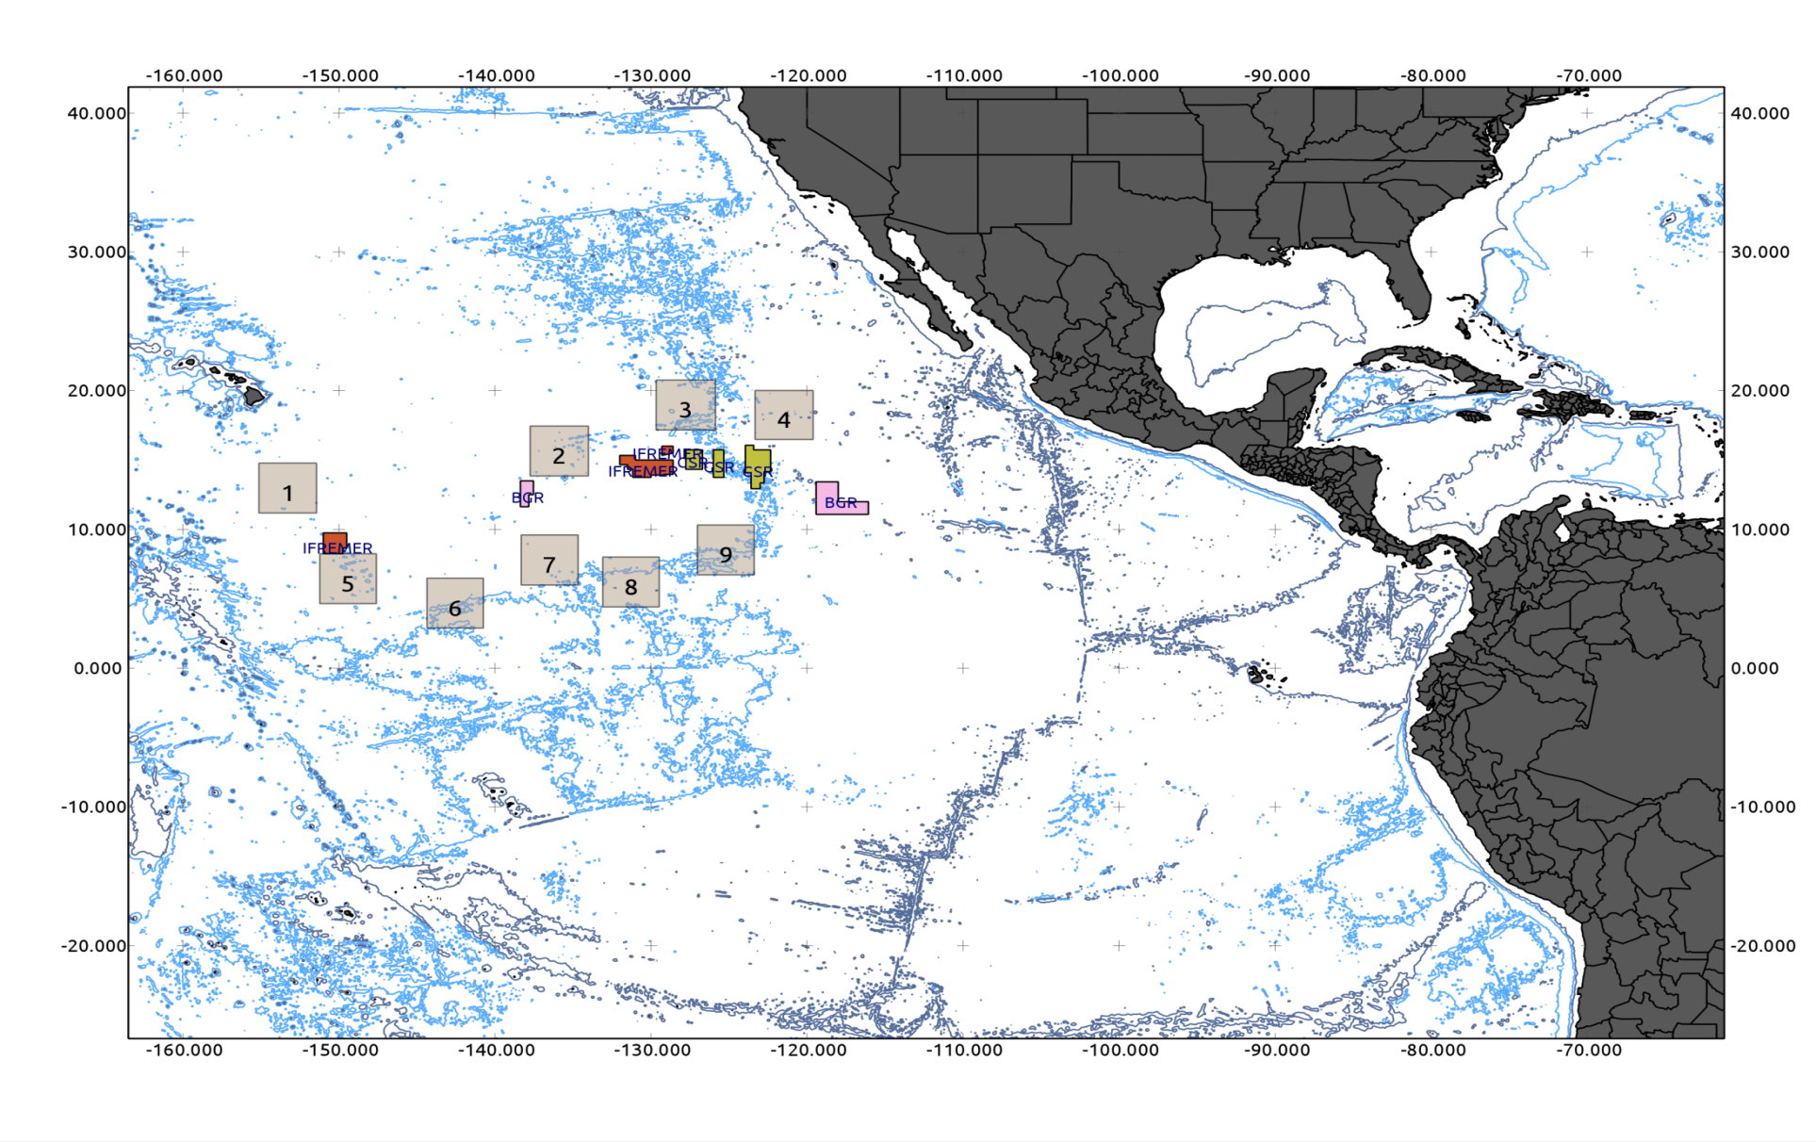
Ecological Impacts of deep sea mining
11 Countries
Approx.10 Mio € of direct funding
3 legs on RV SONNE (118 days) plus other cruises
Project duration: Jan15-Jun 2018
G7, ISA input to mining code
CCZ
Coordinator: Matthias Haeckel,GEOMAR
DISCOL

Slide 9
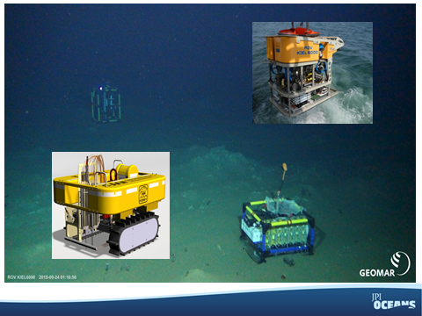
Main objectives
Analyse the long-term ecological impacts of deep-sea mining
Status of disturbed ecosystems in the DISCOL Experimental Area (SO242)
Implications for future nodule mining in the CCZ license areas (SO239 + JC120)
Proof of concept for monitoring technology for ecosystem assessment
Contributing to the regulatory framework of ISA
Added value by cooperating across Europe
State-of-art methodology & technology
Shared infrastructure and equipment
European scientists advice with one voice
Notes:
Analyse the long-term ecological impacts of deep-sea mining:
Spatial (footprint of impact) + temporal scales of abyssal response
Biodiversity, long-range connectivity of species & gene exchange in the CCZ
Comparison of ecosystem characteristics between different areas in the CCZ

Slide 10
MarTERA: ERA-NET Cofund on Marine/Maritime Technologies
30 million Euro call for proposals, of which 20 million from member countries, 10 million from H2020
In addition to the co-funded call other joint activities including other calls are anticipated
Aims to create critical mass and address the needs for new technologies in marine and maritime operations and focus excellence on precompetitive breakthroughs, which can benefit marine and maritime industries in general and make them more competitive in the longer term, thereby maintaining Europe’s competitive edge.

Slide 11
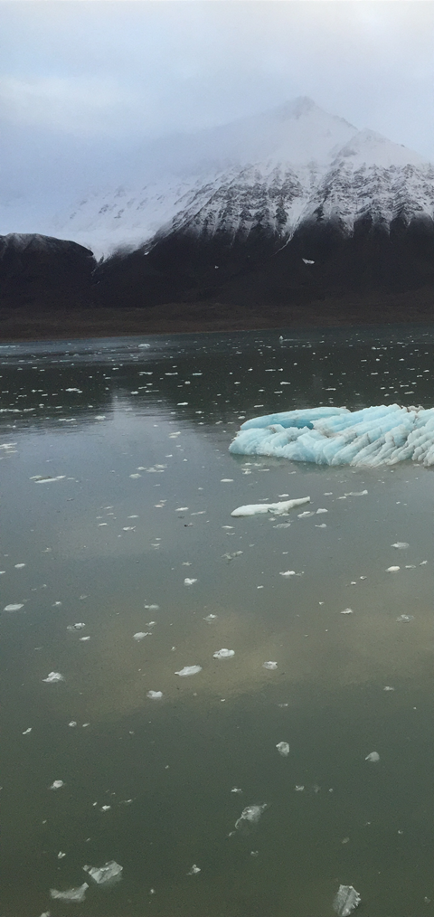
Key Enabling technologies for the ocean sectors
The focus of development in MarTERA is on technologies (instead of sectors) due to their potentially large impact to a wide range of application fields.
Environmentally friendly maritime technologies
Development of novel materials and structures
Sensors, automation
Manufacturing
Safety and Security

Slide 12
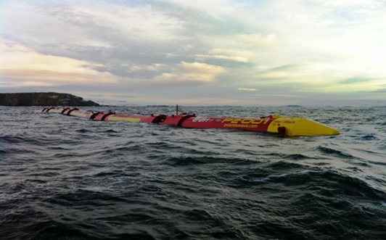
Partners: 17 Funding Agencies from 16 Countries including outside Europe
Part of the EU contribution will be used as “real pot” money
Additional partners/countries can still join
Some partners might fund only industry or only research institutes etc.
At least two partners from two countries for each project.
Argentina
Belgium
Belarus
France
Germany
Ireland
Italy
Malta
The Netherlands
Norway
Poland
Portugal
Romania
South Africa
Spain
Turkey

Slide 13
MarTERA practical information
Dec 15, 2016: Launch of the co-funded call
Feb 15th: Brokerage event (tbc)
31 Mar 2017: Deadline for submission of pre-proposals
Process: Two-stage
Contactpoints and Coordinator :
Dr. Filiz Azlan, Juelich, DE Berlin
Webpage:
https://www.martera.eu/submission/call1

Slide 14
Developing JPI Actions – Oceans and climate
Climate Change Impacts on Physical and Biological Ocean Processes; Effects of Ocean Acidification on Marine Ecosystems
Action: Optimization of Transdisciplinary Marine Monitoring to Support
Assessments of the Physical, Chemical, Biological and Societal Consequences of Climate Change (Including Ocean Acidification) (Lead: FR)
Action: Improved understanding of how climate change can affect ocean processes, ecosystems and the services they provide (Lead: ES + FR)
Discussions with JPI Climate underway for a major joint action in later part of H2020 programme

Slide 15
POLAR SCIENCE?
At the April 2016 Management Board meeting several countries expressed interest in exploring whether JPI Oceans should take any specific actions in the field of Polar (particularly Arctic) science
Conclusion, make strategic links, consider where JPI Oceans might add value
Some related developments
Horizon 2020 Work programme 2014-2015
EU-PolarNet. 2015-2020, Seventeen countries, 22 institutions will develop and deliver a strategic framework and mechanisms to prioritise science, optimise the use of polar infrastructure, and broker new partnerships that will lead to the co-design of polar research projects that deliver tangible benefits for society.
AORAC- Transatlantic initiatives (US, Canada, EU)
Horizon 2020 Work programme 2016- 2017 The Arctic Dimension
BG-09-2016: An integrated Arctic observation system
BG-10-2016: Impact of Arctic changes on the weather and climate of the Northern Hemisphere
BG-11-2017: The effect of climate change on Arctic permafrost and its socio-economic impact, with a focus on coastal areas
SC5-05-2016: A 1.5 million year look into the past for improving climate predictions
INFRAIA-01-2016/2017 “Research infrastructures for terrestrial research in the Arctic” ~10 million Euro.
YOPP - The Year of Polar Prediction (mid-2017 to mid-2019) http://www.polarprediction.net/yopp.html Enable a significant improvement in environmental prediction capabilities for the polar regions and beyond, by coordinating a period of intensive observing, modelling, verification, user-engagement and education activities in order to improve polar prediction capabilities on a wide range of time scales in both polar regions: a preparation phase (2013-2017), YOPP itself (mid-2017 - mid-2019), and a consolidation phase (2019-2022).

Slide 16
THANK YOU
Jacky Wood,
JPI Oceans secretariat
Email: jkw@rcn.no
Website: www.jpi-oceans.eu
Twitter: @jpioceans

